Slide 1
TECHNICAL PRESENTATION | 09.09.2015

Slide 2
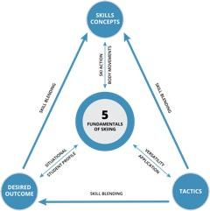
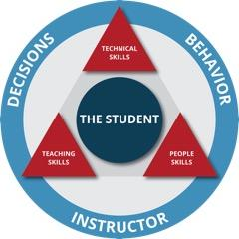

Slide 3
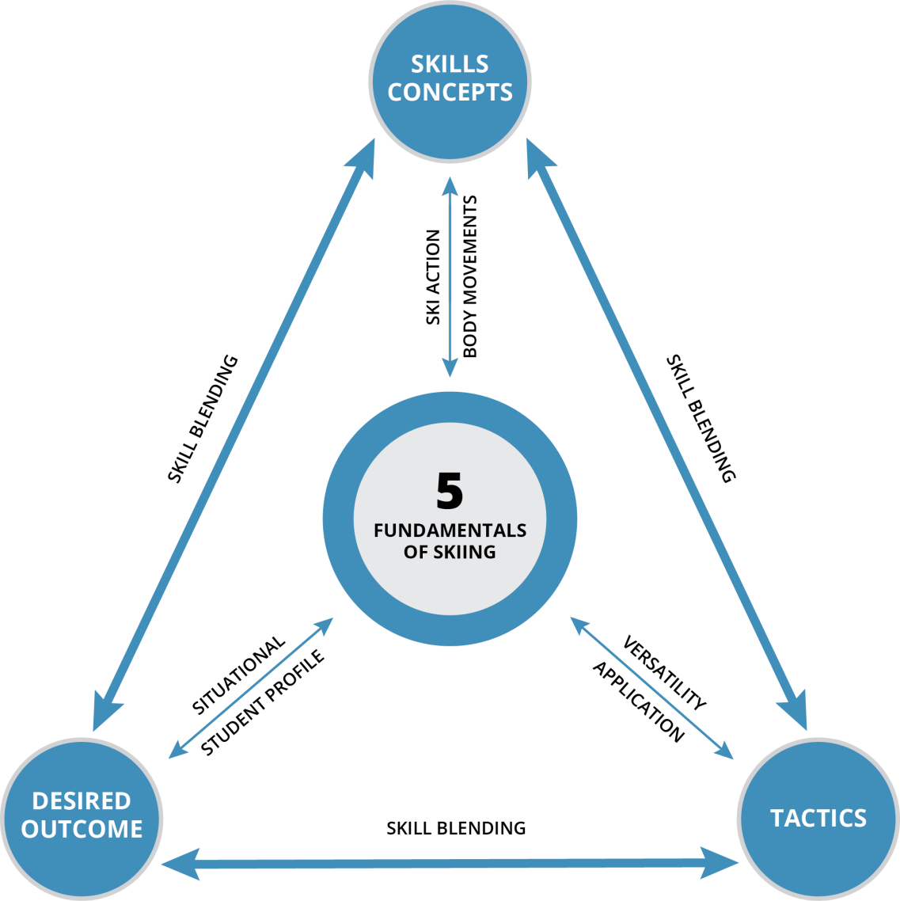
PSIA Technical Approach to Alpine Skiing
Notes:
‹#›

Slide 4


After Interski 2011, we recognized that our diversity was good but we needed to define American skiing technically.
Notes:
Through that process, and through interacting, we realized that our diversity was our strength -- and our weakness. We identified many good types of skiing, but had not clearly defined our beliefs about any.
We recognized that it was important to identify the difference between coaching cues or personal biases and “truths” or fundamentals of GREAT skiing.
We came up with 5 things that we value as essential to GREAT skiing. Performance Outcomes BUT also a BASE to go explore things.
This process of defining fundamentals evolved over years. From a worksheet that was largely based on coaching cues and personal biases to 5 fundamentals that we believe are critical to good skiing. Things that define GREAT skiing for us.

Slide 5
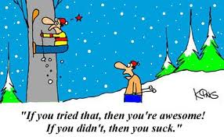
5 Fundamentals – Why!
This is what we think GREAT SKIING is.

Slide 6
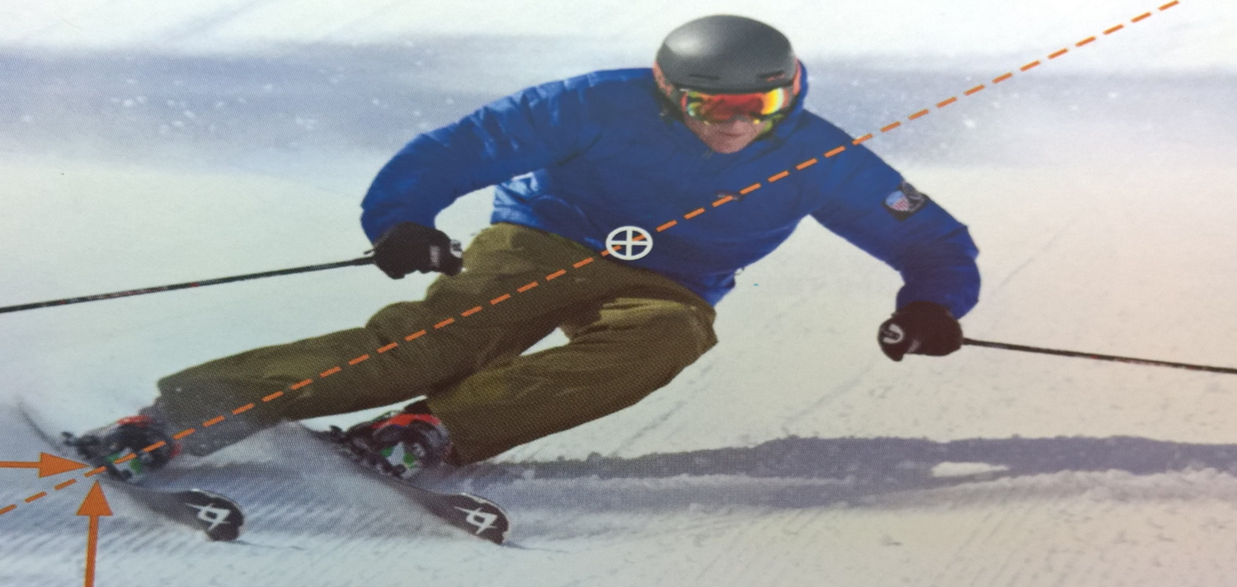
5 Fundamentals of Great Skiing
1. Control the relationship of the CM to the BoS to direct pressure along the length of the ski.
.
Notes:
‹#›
The Skills Concept has to do with the action of the skis. There are THREE ways to move them. We can twist them, tip them, or bend them. Hence, we have R, E, and P.
Of course there are associated body movements that we do to effect the action of the skis, I.E, we twist our legs to twist the skis, etc.

Slide 7
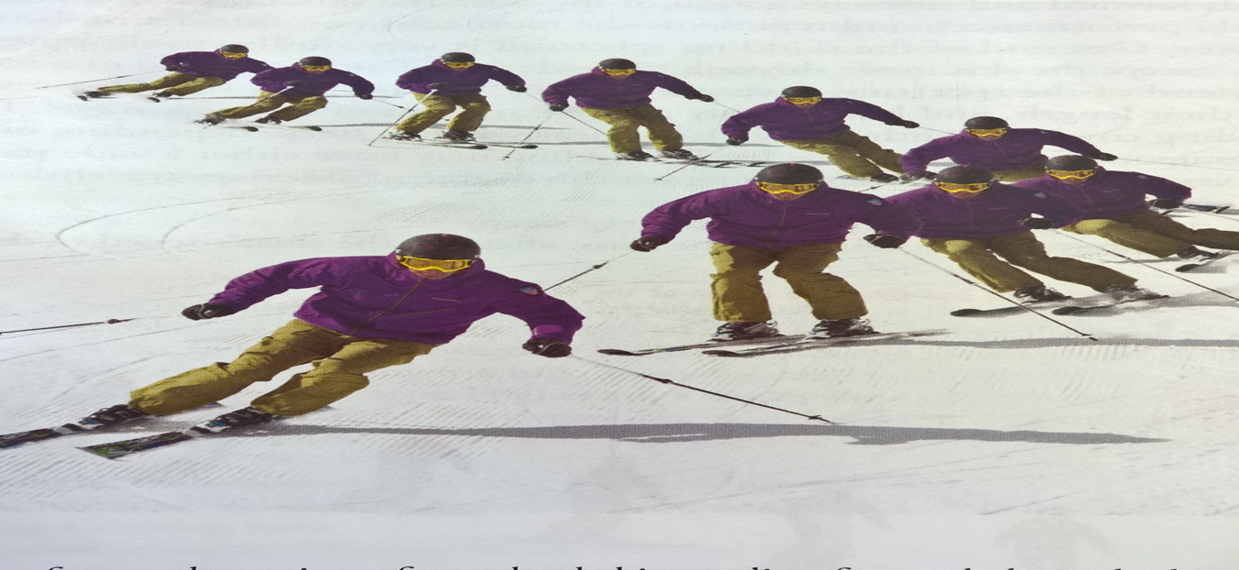
5 Fundamentals of Great Skiing
2. Control pressure from ski to ski and direct pressure to the outside ski.
Notes:
‹#›
Bar Argument
Explain different between outcome or source – must be in balance in order to effectively apply skills AND effectively applying 3 skills will put you into balance.

Slide 8
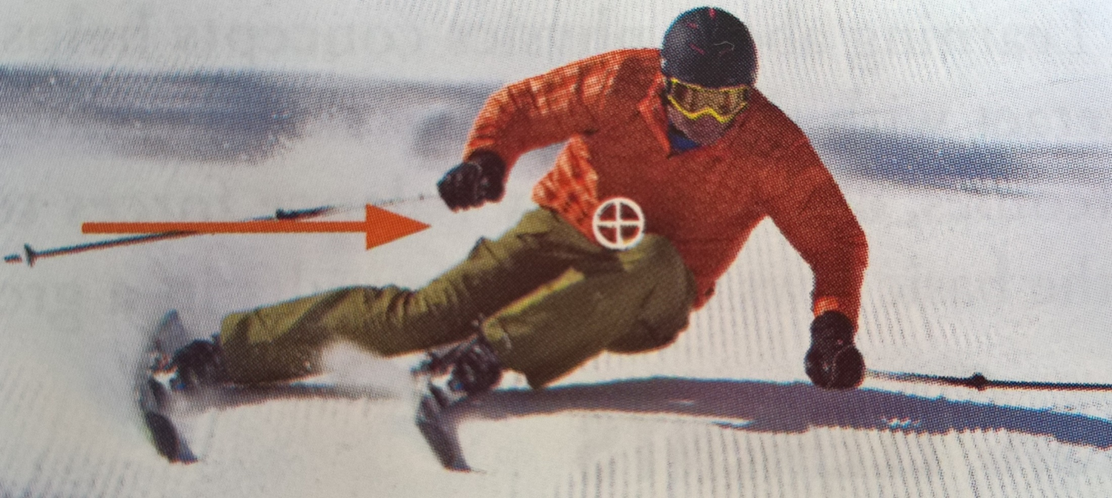
5 Fundamentals of Great Skiing
3. Control edge angles through a combination of inclination and angulation.

Slide 9
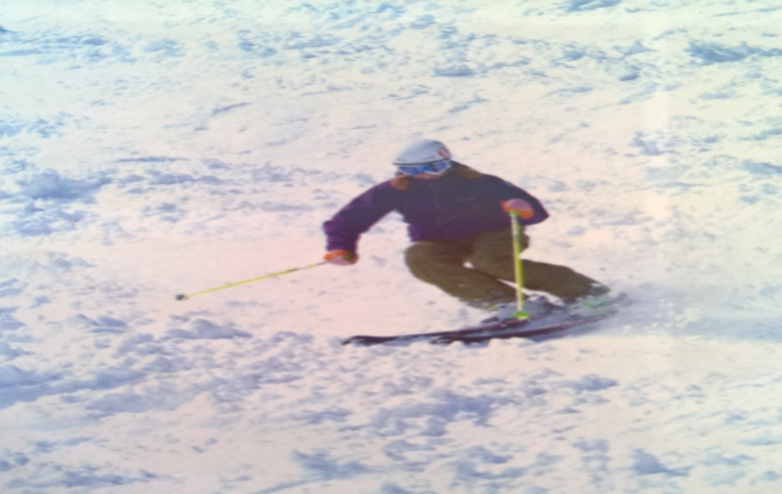
5 Fundamentals of Great Skiing
Control the skis’ rotation with leg rotation, separate from the upper body.

Slide 10
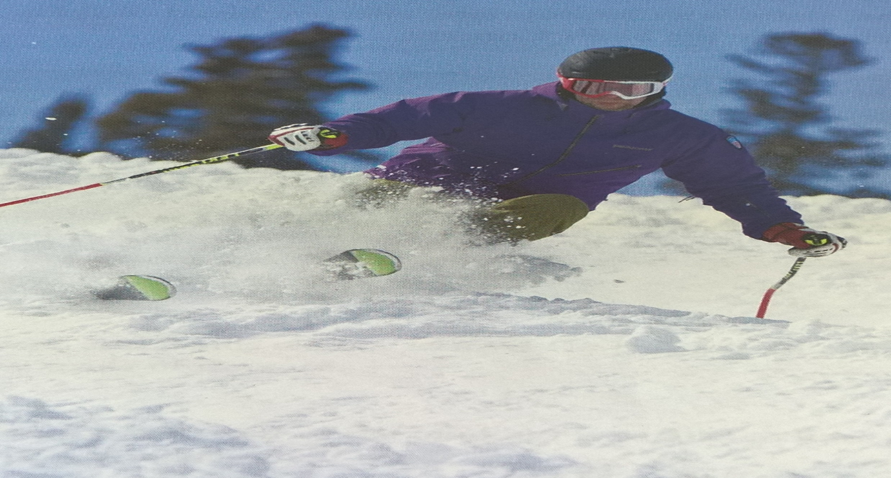
5 Fundamentals of Great Skiing
Regulate the magnitude of pressure created through ski/snow interaction.

Slide 11
5 Fundamentals of Great Skiing
Control the relationship of the CM to the BoS to direct pressure along the length of the ski
2. Control pressure from ski to ski and direct pressure to the outside ski.
3. Control edge angles through a combination of inclination and angulation.
4. Control the skis’ rotation with leg rotation, separate from the upper body.
5. Regulate the magnitude of pressure created through ski/snow interaction.

Slide 12
Skills Concept
Allows us to look at ALL skiing
- Rotational control
Edge control
Pressure control
Ski Action
Body Movements
and

Slide 13
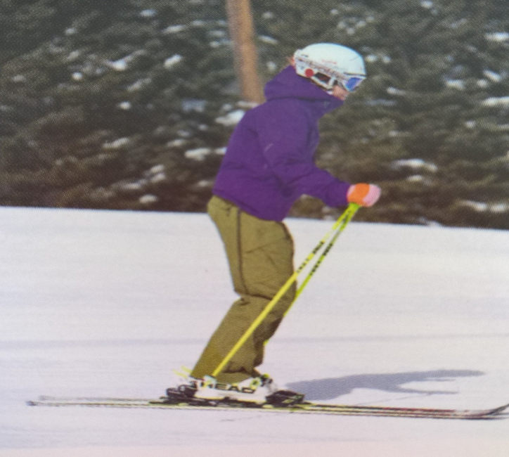
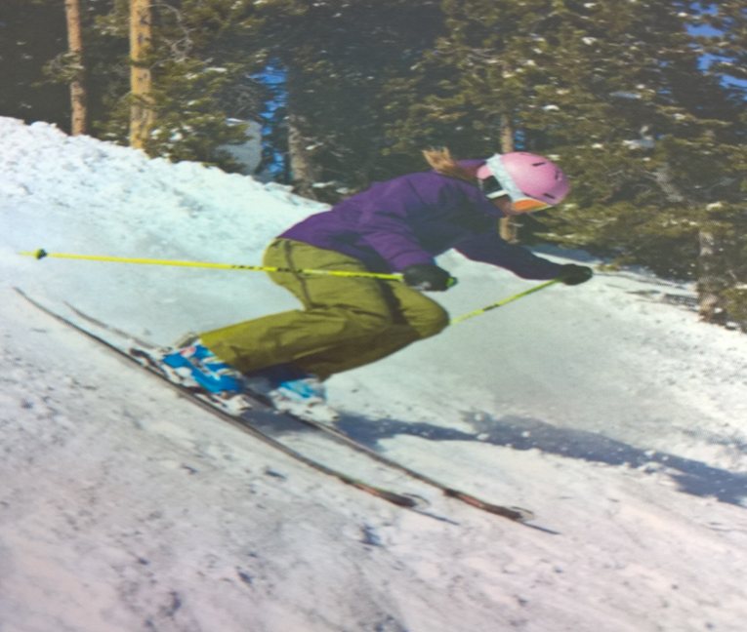
Balance
Source or Outcome?
  Athletic stance – source
  Effective movements – outcome

Slide 14
Source or Outcome??
A common debate in skiing is whether a state of balance creates the ability to move effectively, or if moving effectively results in a state of balance.
The simple answer is “YES” defining the dual role of balance in skiing.

Slide 15
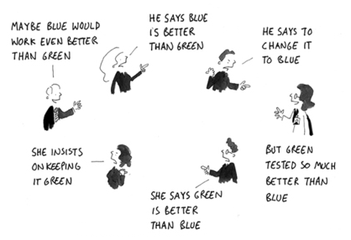
Issue that we face in the USA
Coaching Cue vs. Fundamental

Slide 16
Possible Examples
Face the fall line
Long leg short leg
Lift the inside hip
Etc.
Etc.
Etc.
Turn legs more than upper body
Pressure to outside ski

Slide 17
5 Fundamentals allow us to . . .
-Speak the Same Language
-Understand Coaching Cue vs. Fundamental
-Develop Lesson Content
-Analyze Movements
-Self Coach/Learn
-Be consistent with Exam Standards
Notes:
Often times people get caught up in details of coaching cues – that often become dogma - versus understanding the true fundamental.
Explain that coaching cue are great – not negative. But that it is important to recognize the ultimate goal, and that the coaching cues are merely one way to accomplish the goal of improving performance of a specific fundamental.
This slide is an example of how information gets passed along and gets changed along the way until the original meaning has little to do with the understanding at the end. The coach may have been coaching a fundamental and using a coaching to cue to accomplish that. At the end, the coaching cue gets erroneously interpreted as the important thing to do or to remember.
Examples of those Coaching Cue vs. fundamental? Face downhill. Vertical Femurs. Lift the Inside Hip. Long leg, Short leg. Move to little toe edge.

Slide 18

FREE access PSIA/AASI online manuals:
1. App store: Search “Snow Pro Library”
2. Click “member login”
Username: USA
  Password: Interski2015
3. Enjoy!

