Slide 1
DEVELOPMENTAL FRAMEWORK| INTERSKI 2015

Slide 2
STUDENT CENTERED SINCE THE 70’S
For 40 years, PSIA-AASI have delivered a message of Student Centered Teaching
Most major alpine nations consider their own systems to be Student Centered to one degree or another

Slide 3
STUDENT CENTERED SINCE THE 70’S
When TECHNIQUE was the focus, decisions for the instructor were limited and pathways to instructor development were obvious
PROGRESSIONS
PERFORMANCE

Slide 4
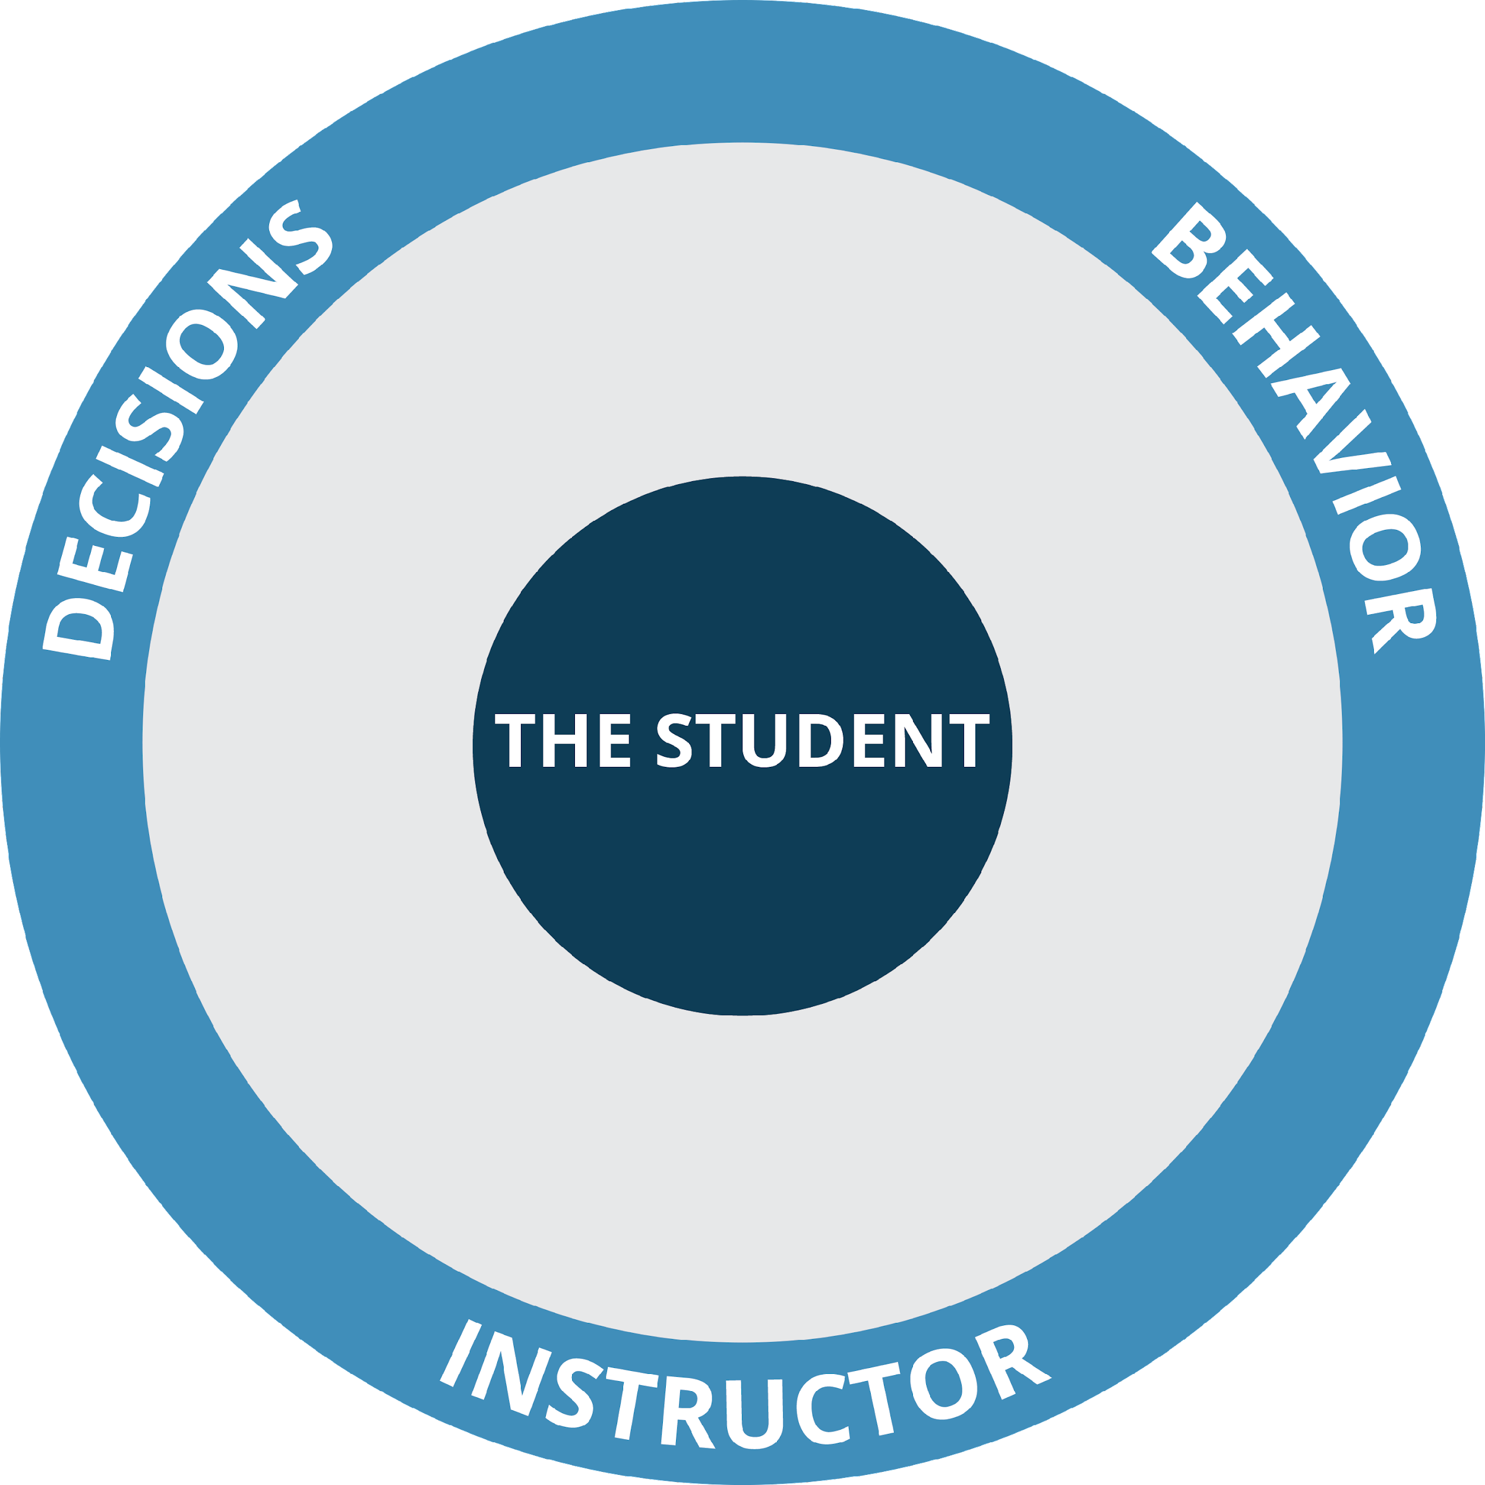
STUDENT CENTERED SINCE THE 70’S
Putting the STUDENT in the center created complexity
The student brings an infinite number of variables to the lesson environment
The instructor must base decisions & behavior in these variables
PROGRESSIONS
PERFORMANCE

Slide 5
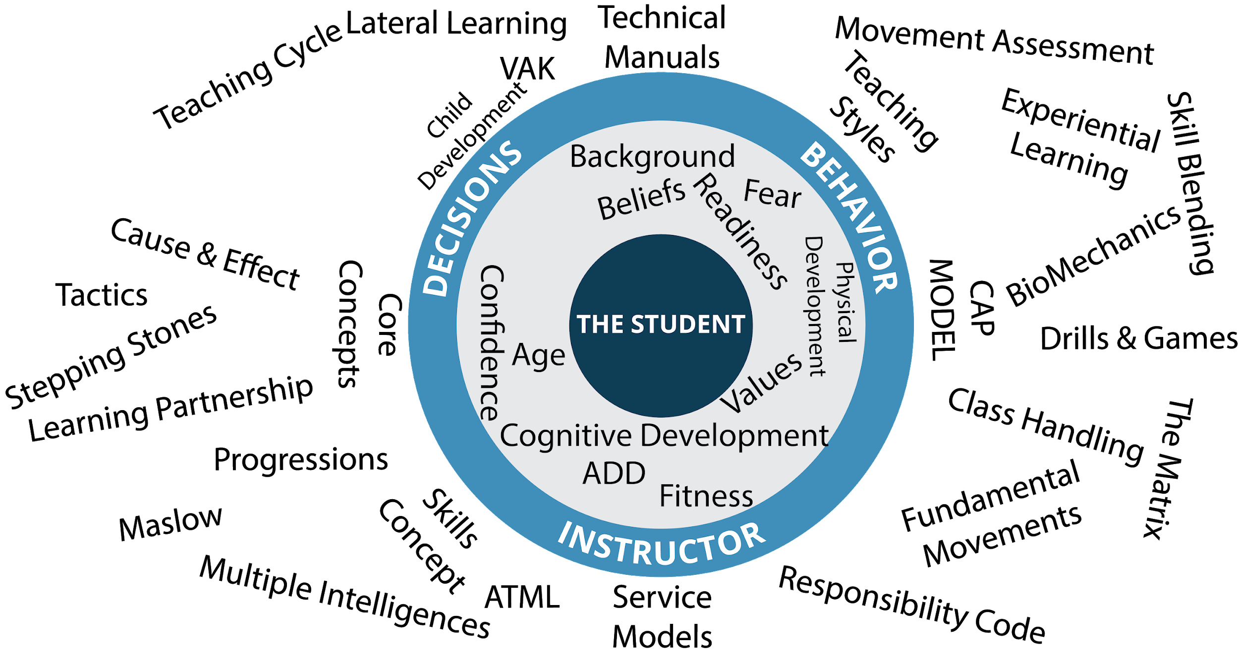
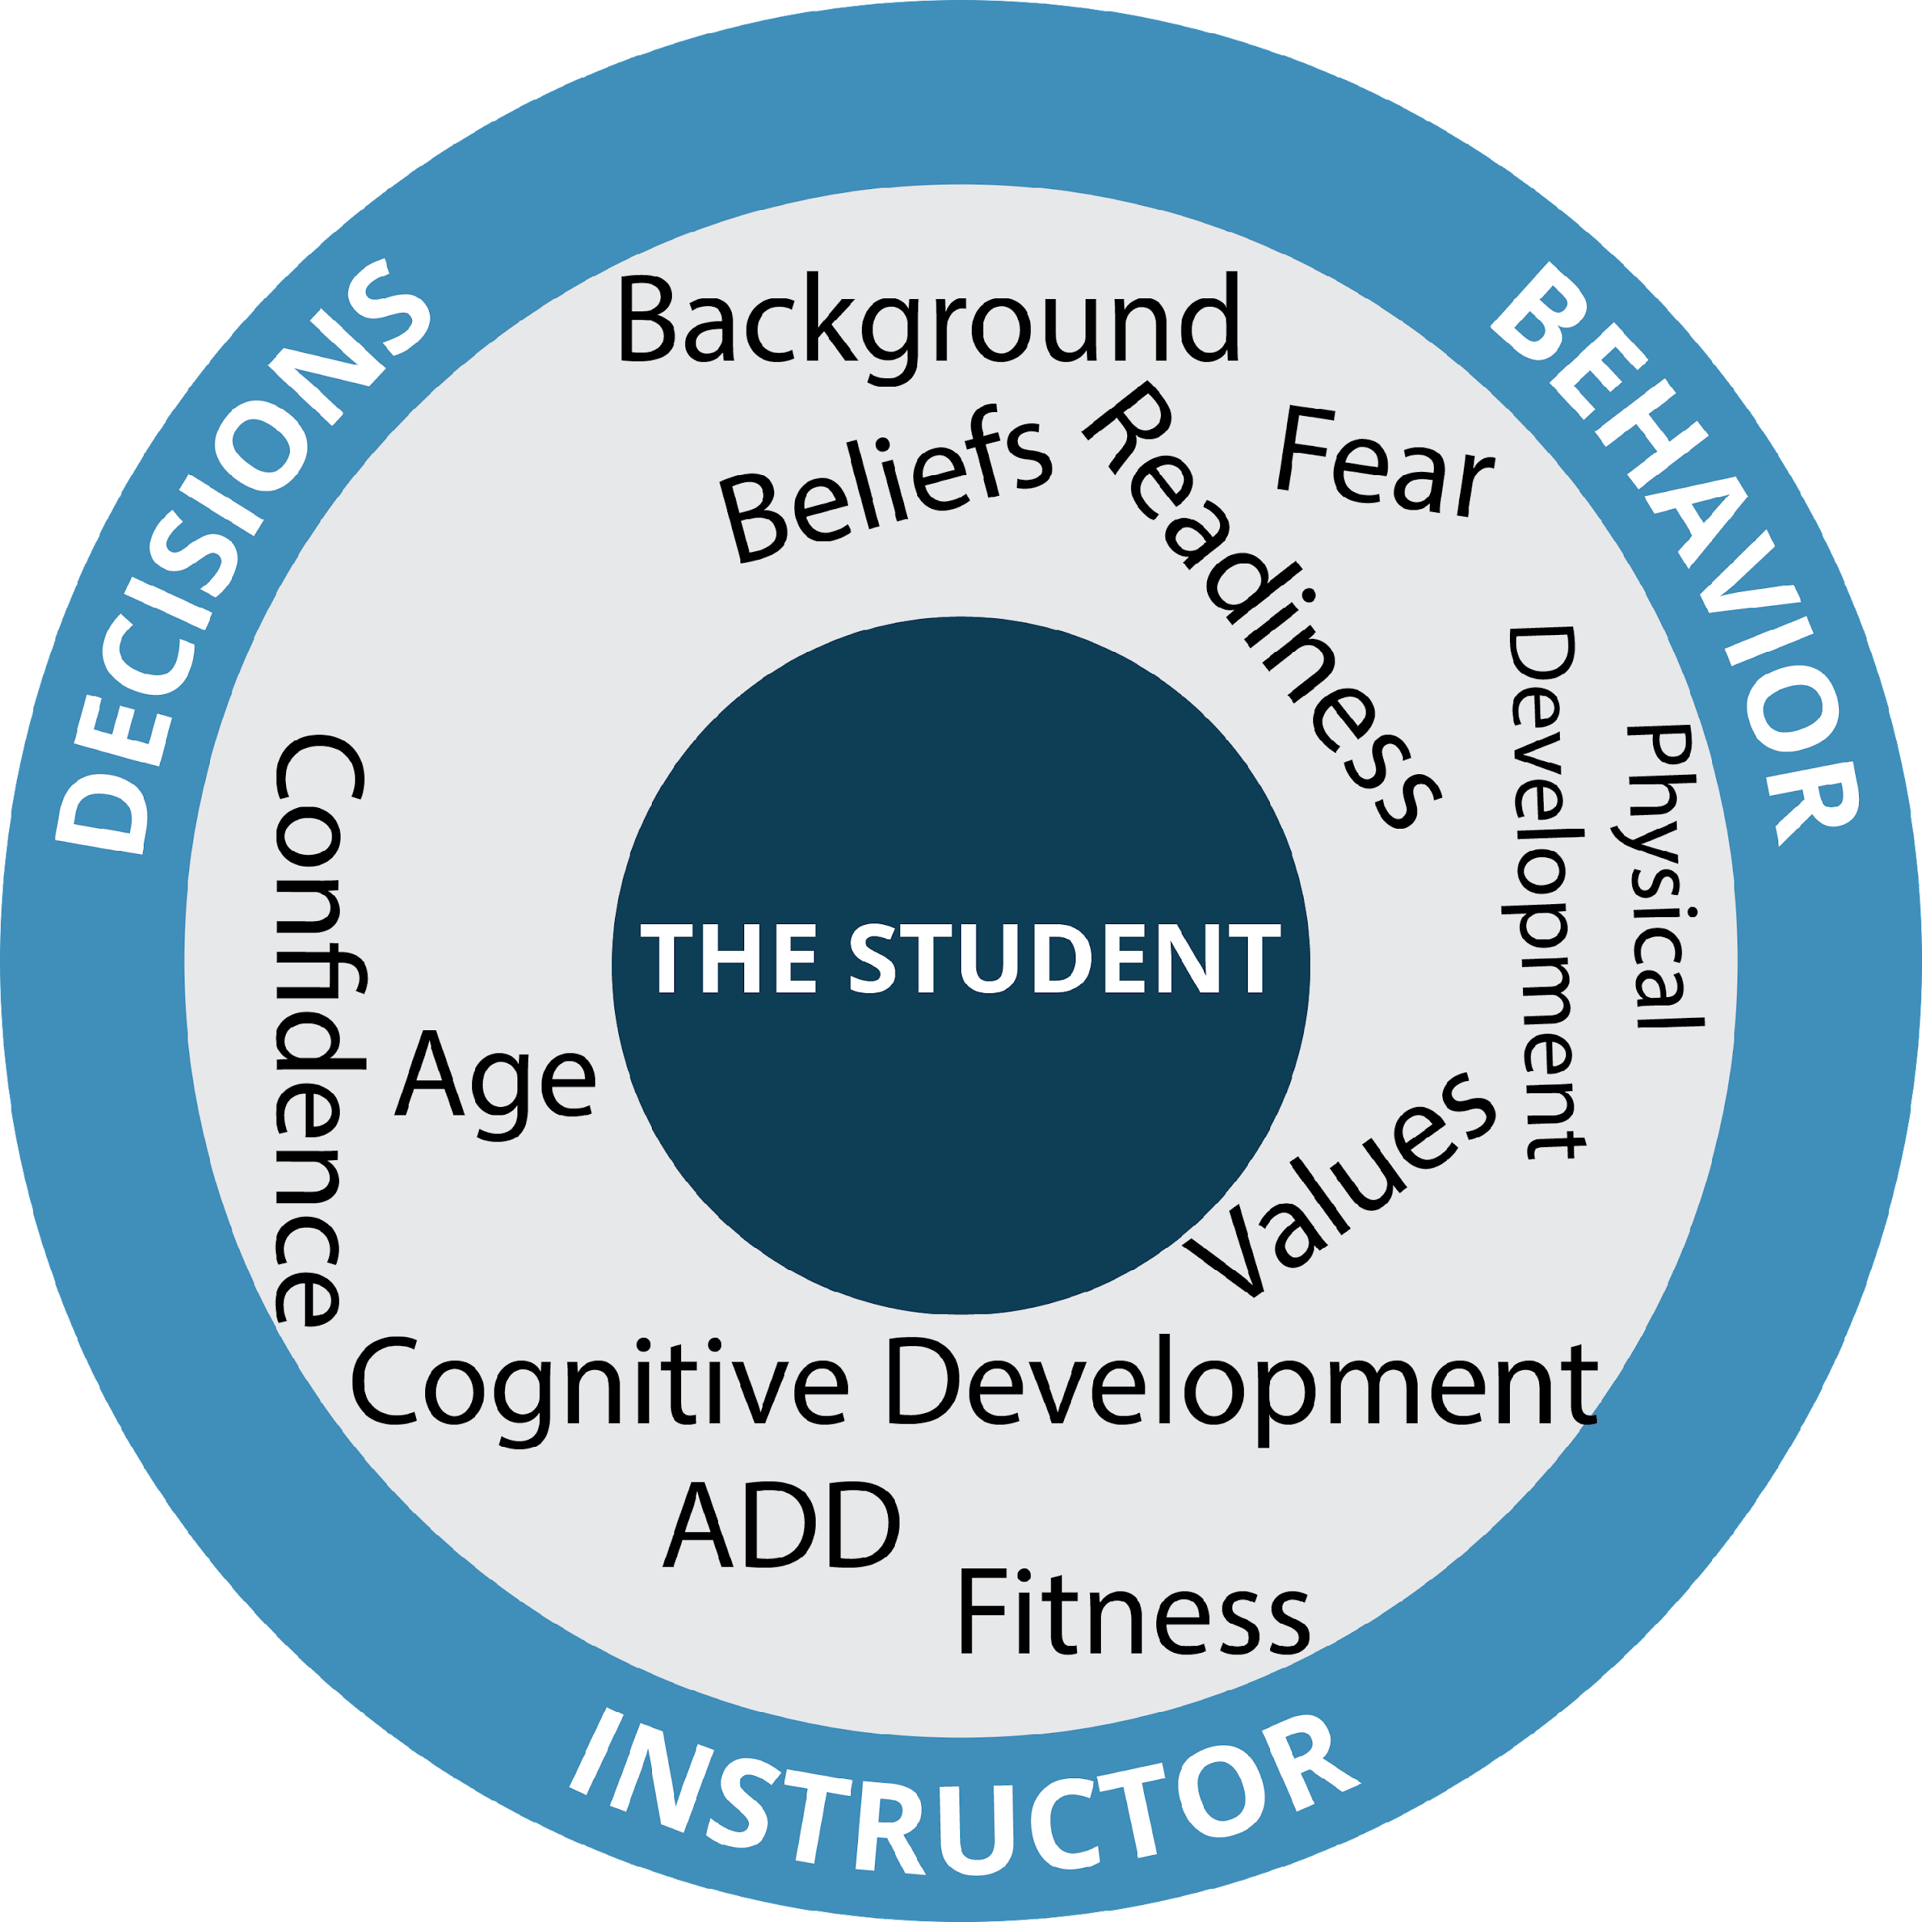
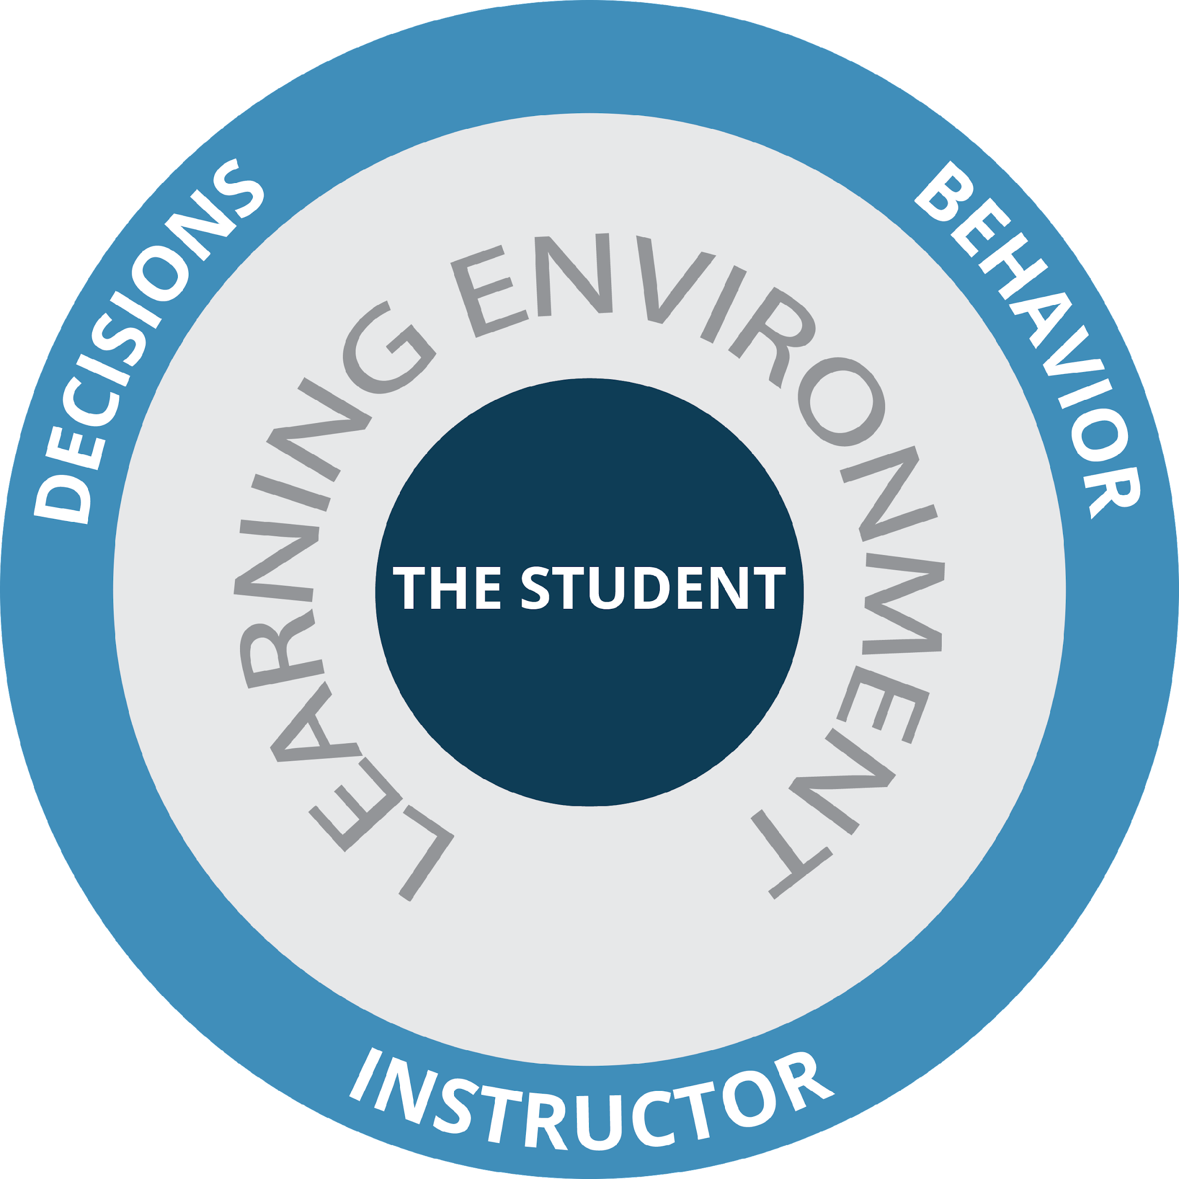
Motivation
Limitations
Abilities
Notes:
THE SPARK IS WHAT WE ARE AFTER – CONNECTION/LEARNING. THIS IS HOW WE GROW OUR SPORT. THIS IS OUR GOAL. THE MORE STUFF IN THE CENTER WE ARE ARE ABLE TO MEET, THE MORE LIKELY THE SPARK IS TO HAPPEN AND THE LARGER IT IS LIKELY TO BE.

Slide 6
EVOLVING STUDENT CENTERED TEACHING
The abundance of information available to instructors has clouded the clarity for instructors
SIMPLIFY…. DECISION MAKING for instructors.
SIMPLIFY…. PATHWAYS FOR DEVELOPMENT
Enhance our CONNECTION to grow our sport

Slide 7
THE DEVELOPMENTAL FRAMEWORK

Slide 8
ONE WORD: SIMPLIFY
To help instructors make immediate lesson decisions to maximize student learning.
To help training staff identify needs for long term development of individual instructors
To help schools identify trends and needs for whole school development
To help our organization identify National trends and needs for National development

Slide 9
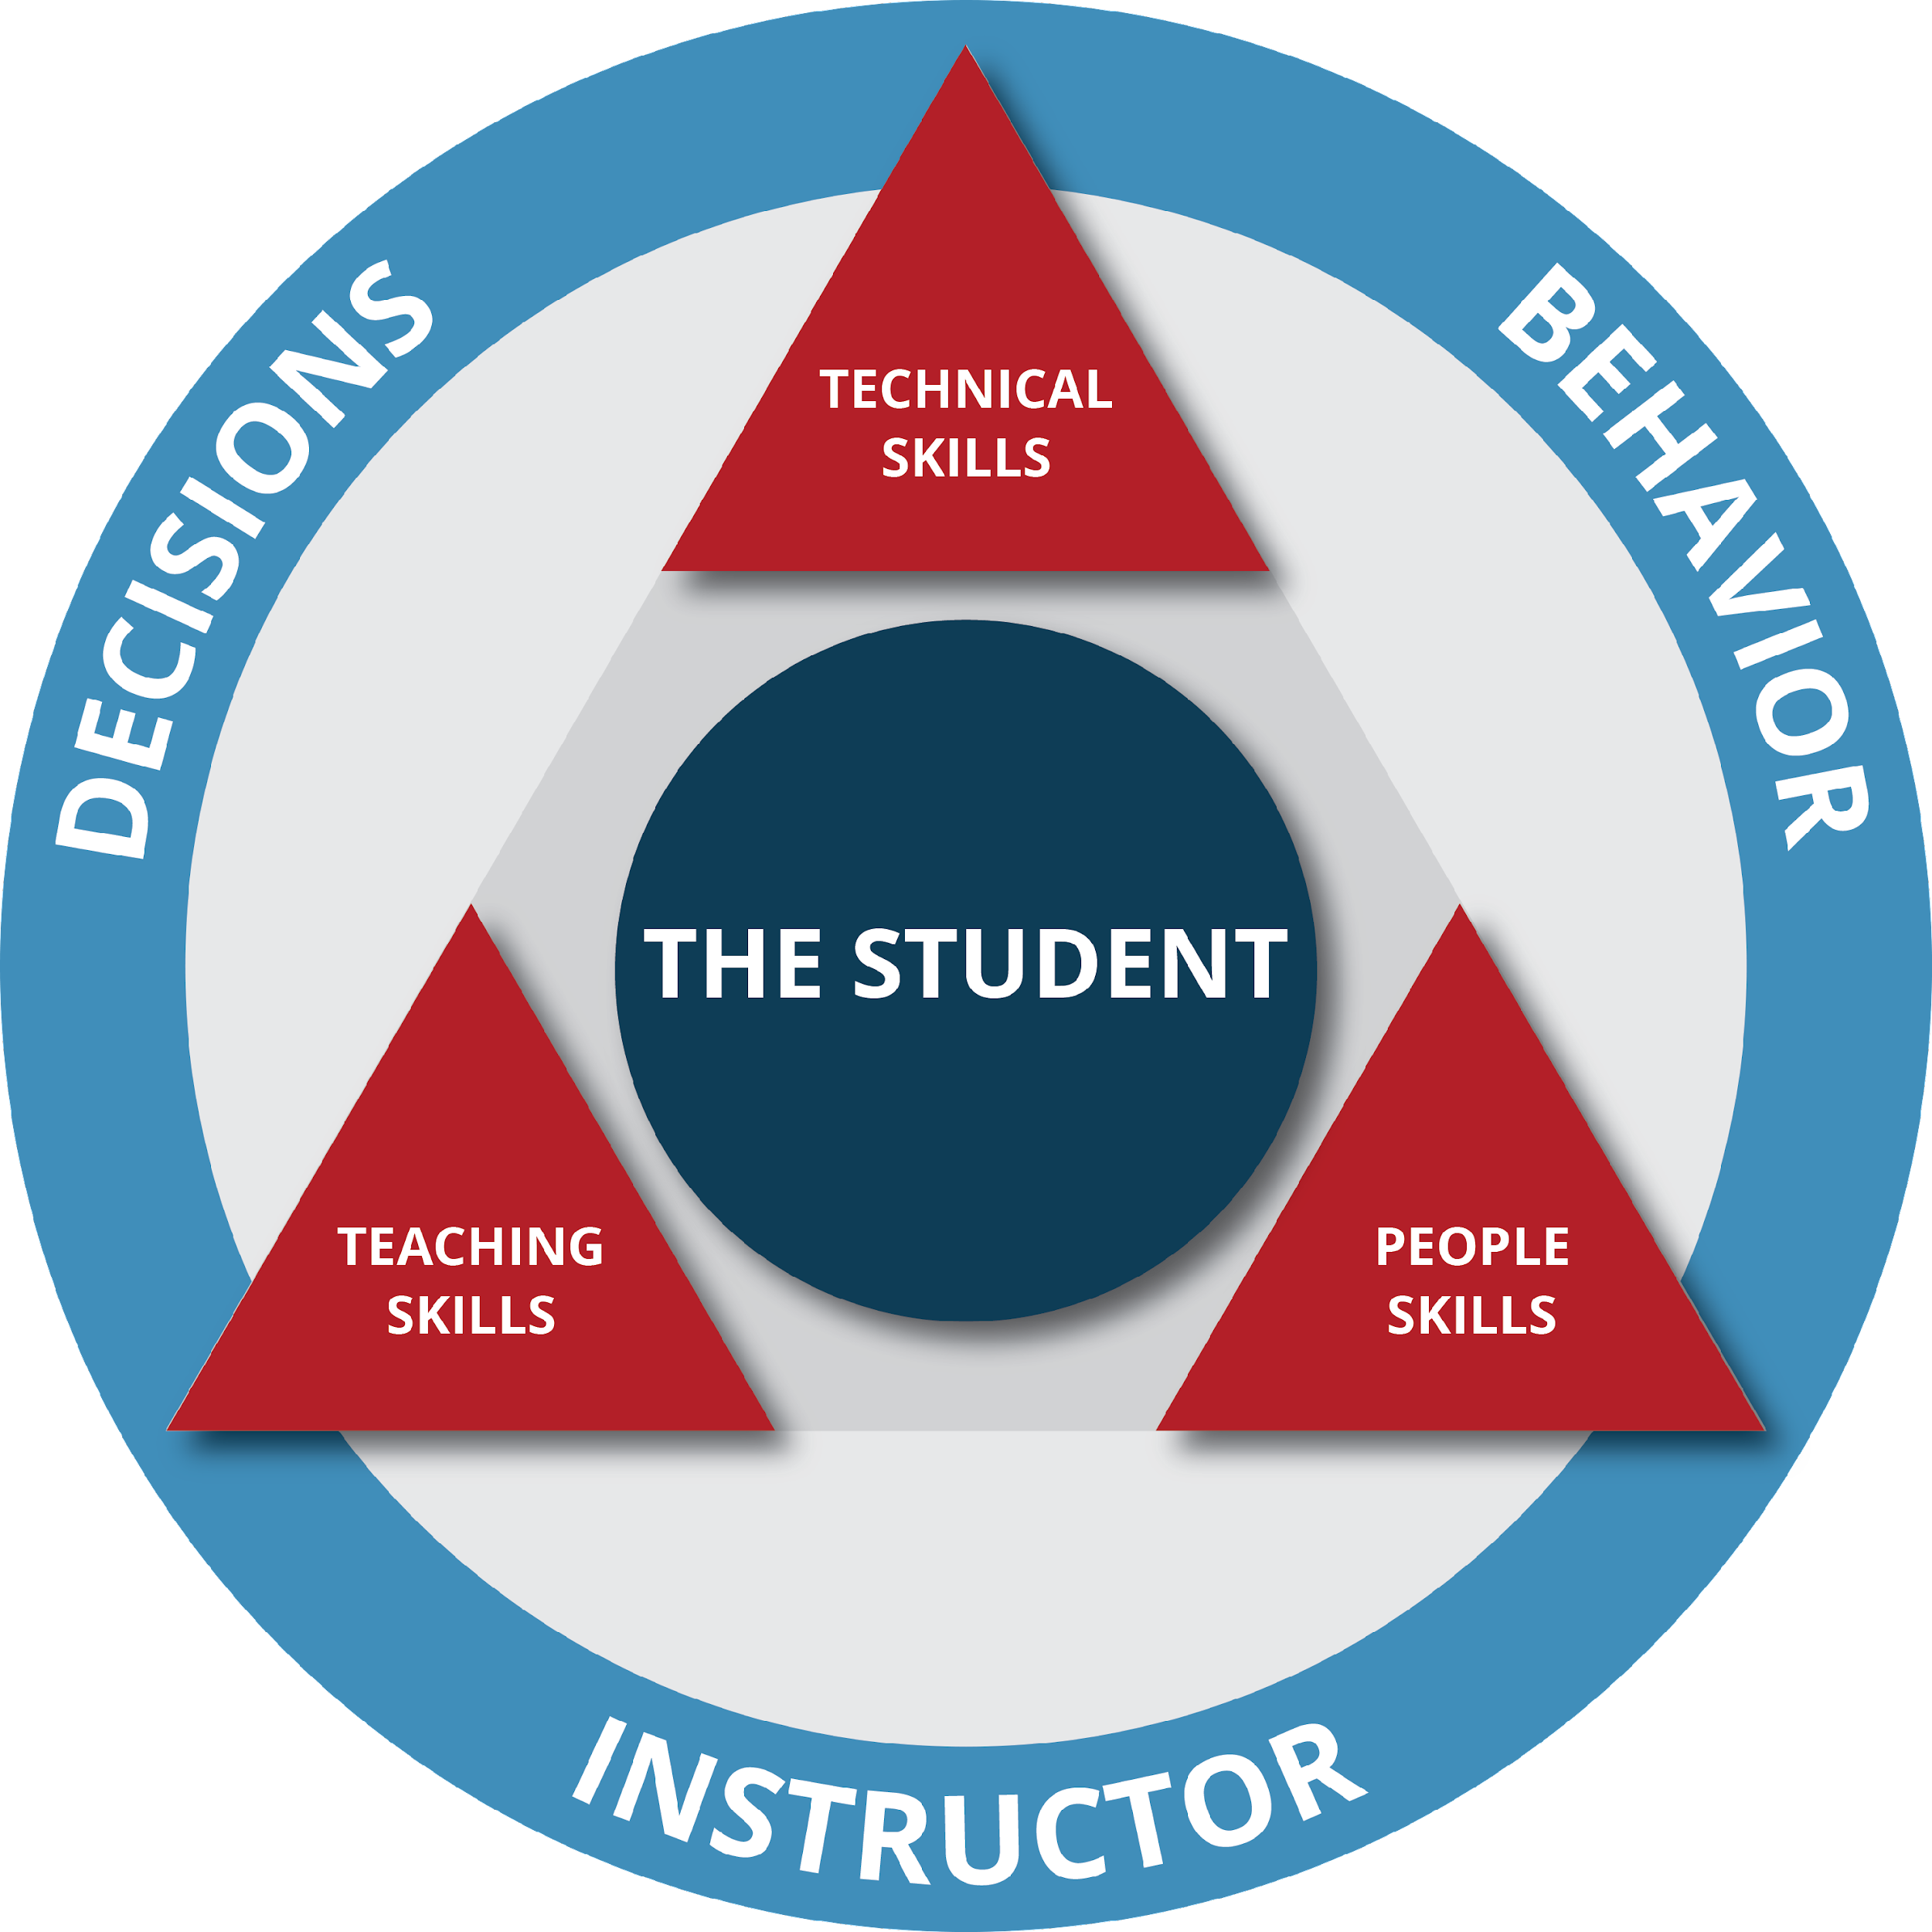
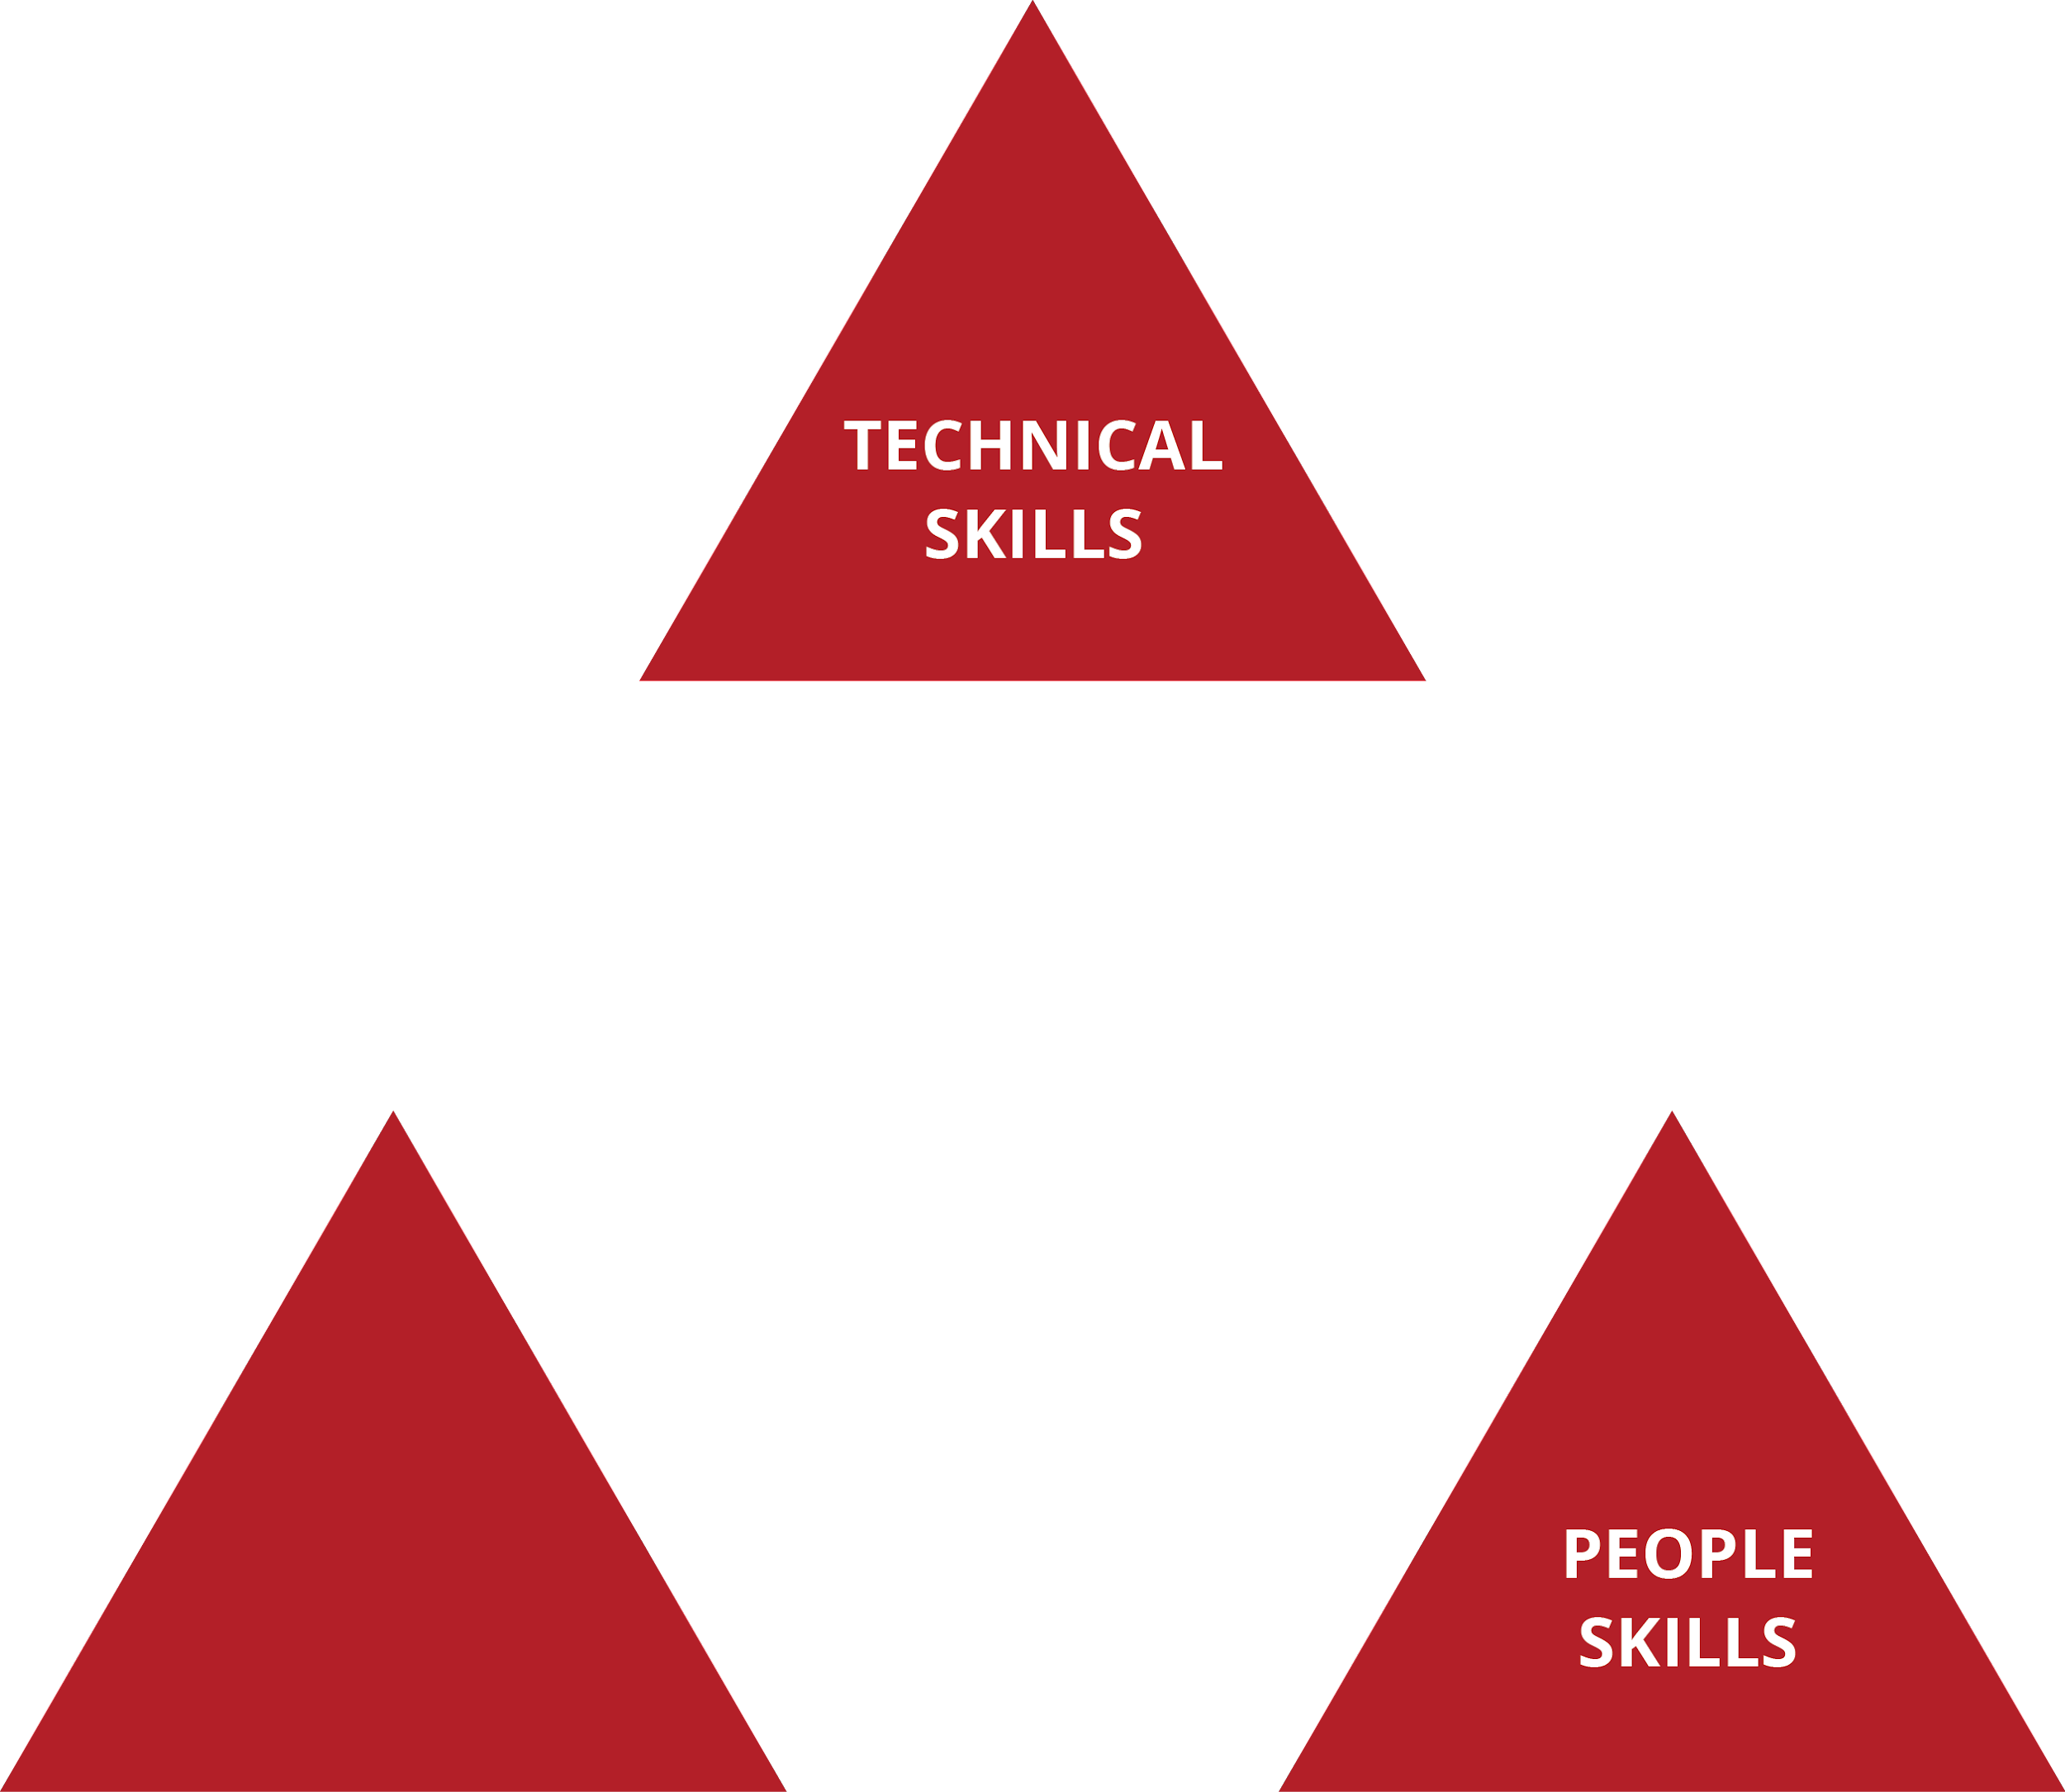
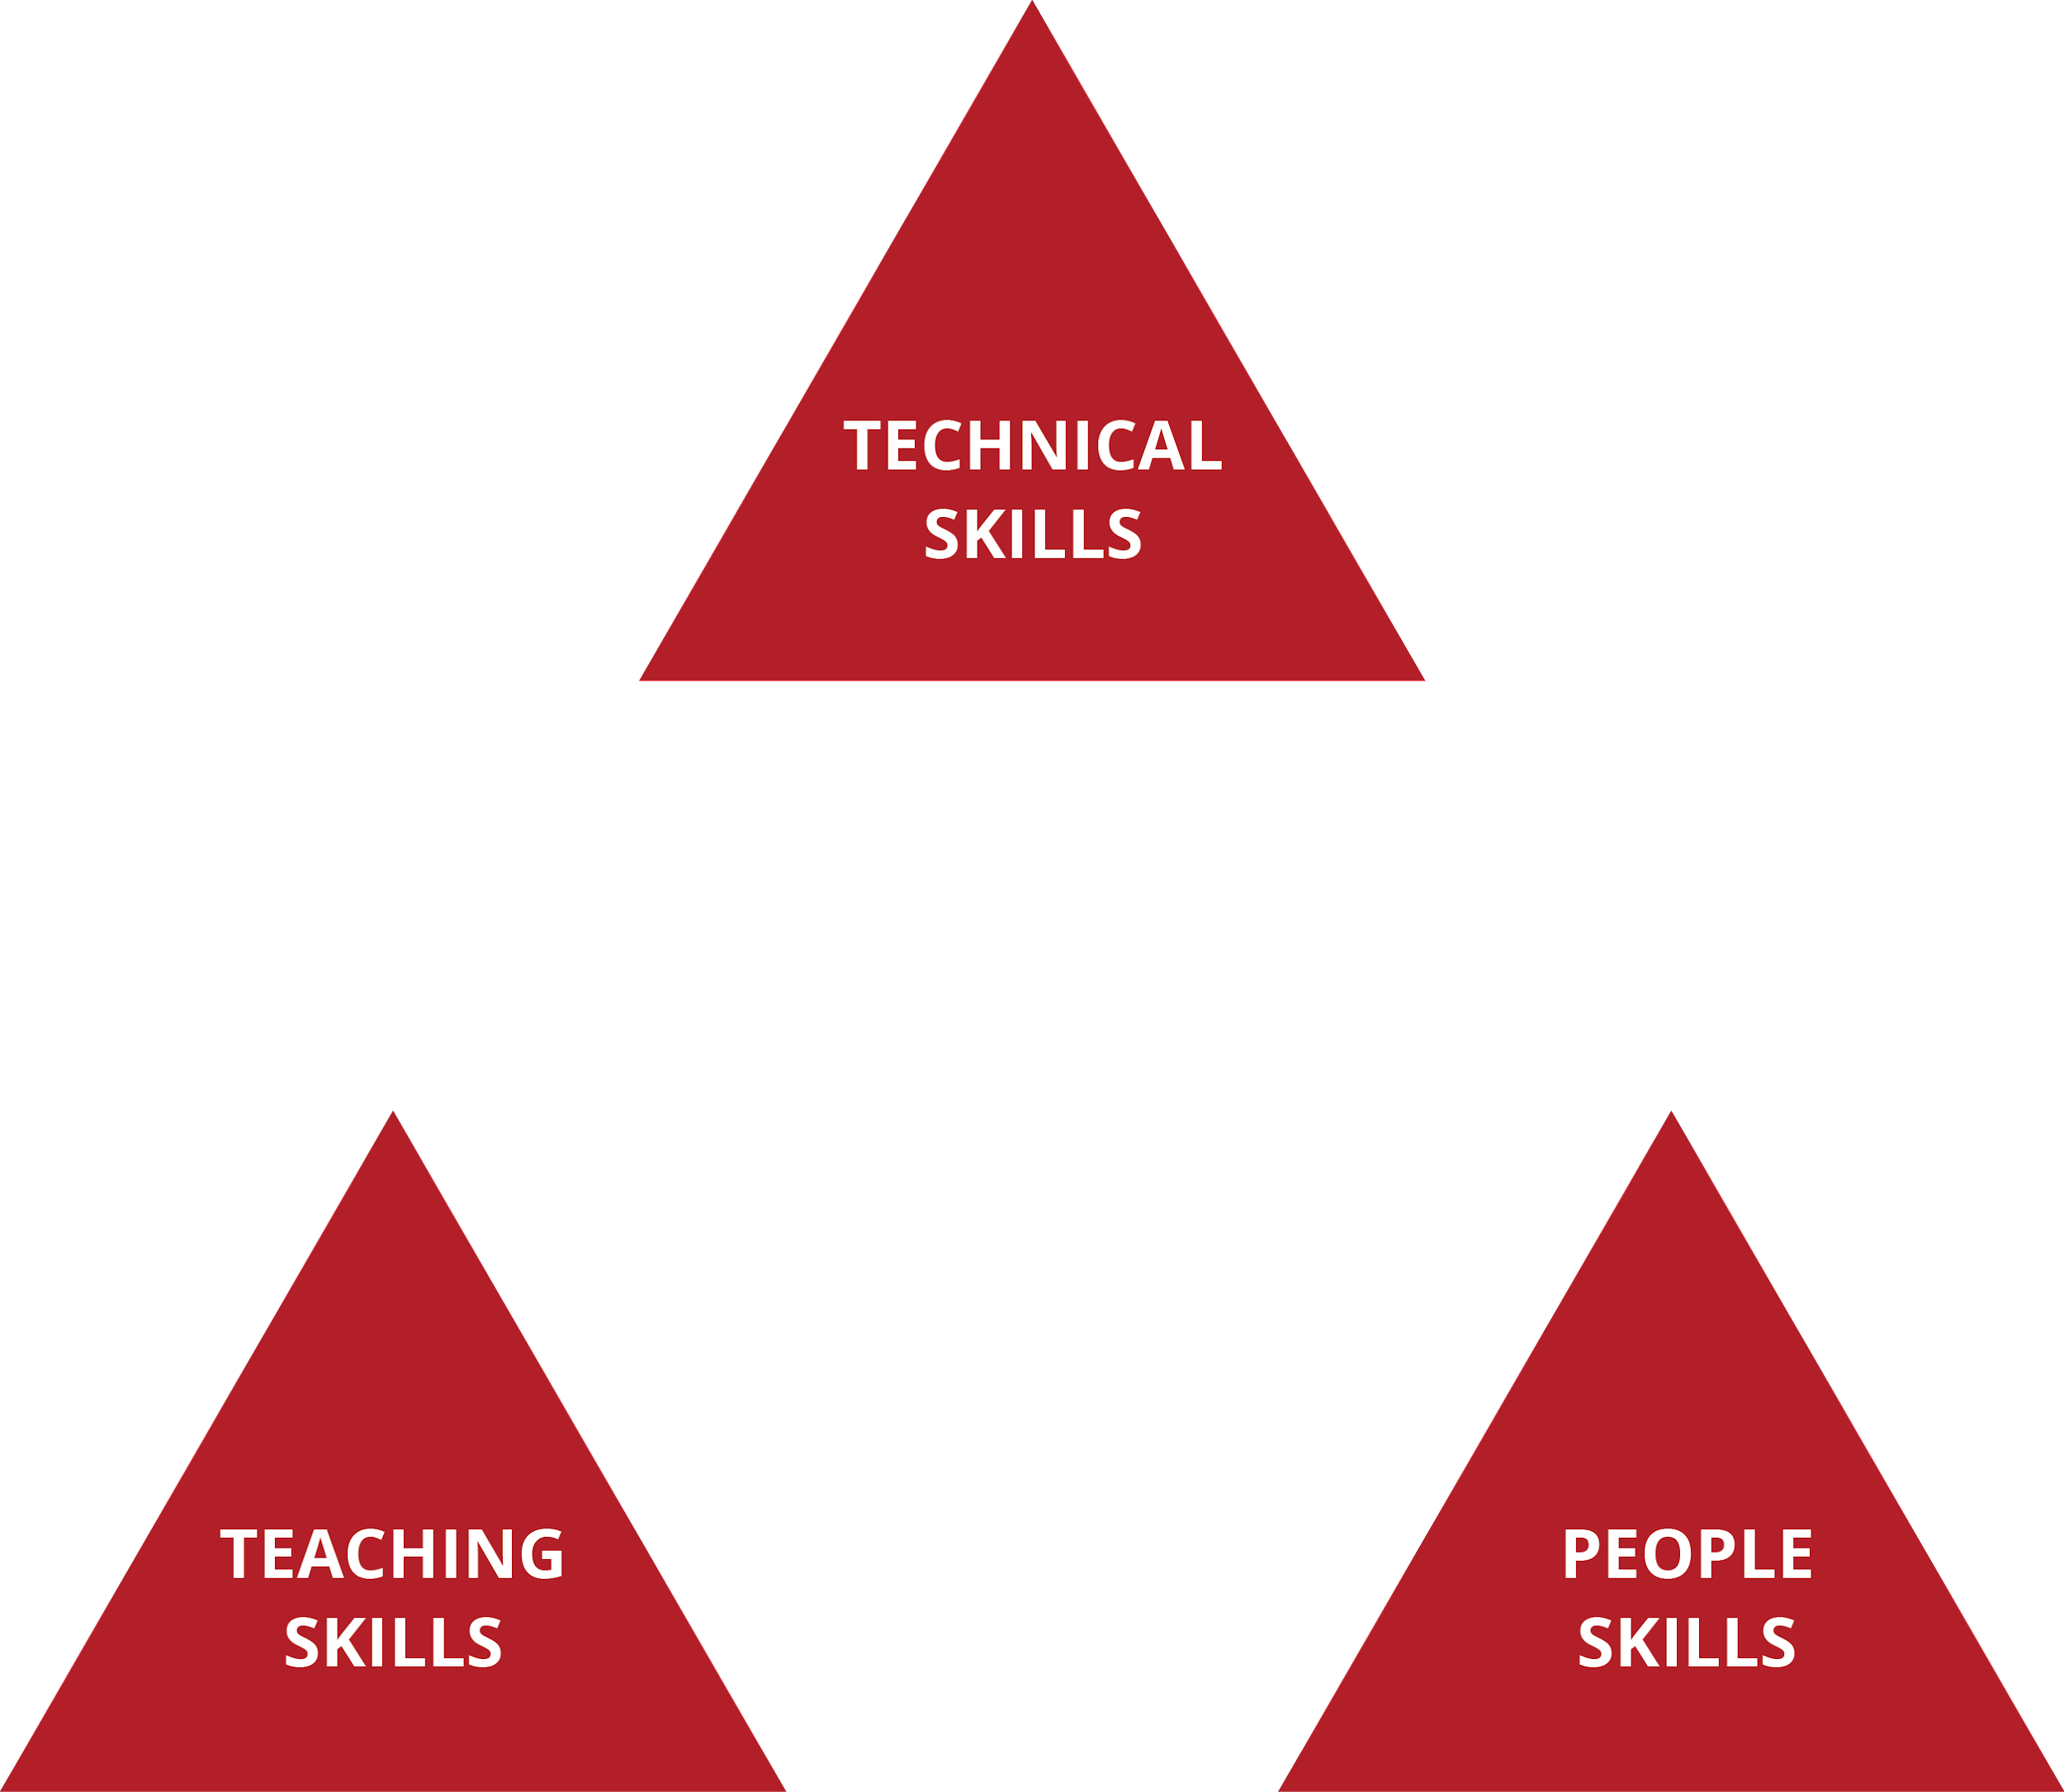
WHAT MAKES A GREAT INSTRUCTOR?

Slide 10
DEVELOPMENTAL FRAMEWORK
The instructor adjusts the fundamentals based on the student like spokes on a wheel to keep the wheel true and the learning partnership intact
CONNECTION
HUB
WHEEL

Slide 11
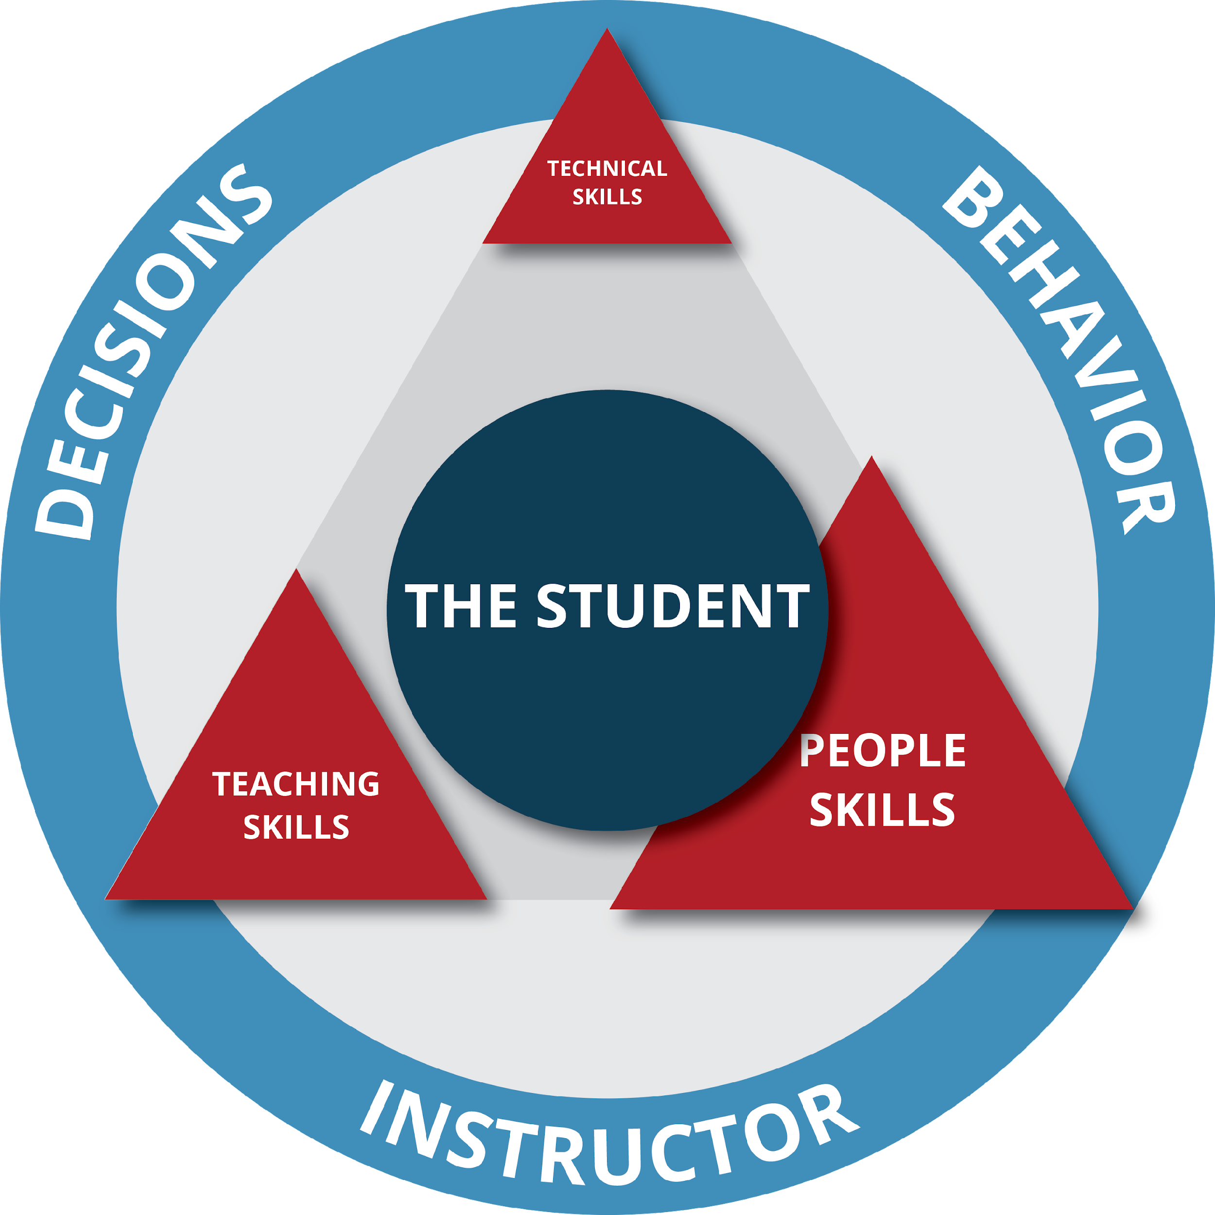
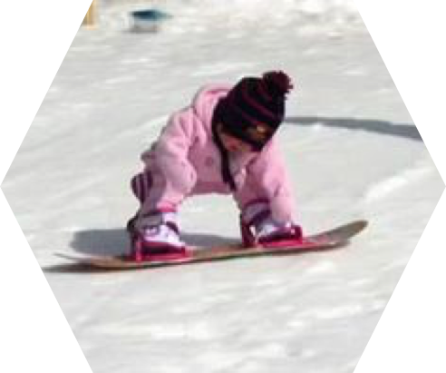
#1: SIMPLIFY INSTRUCTOR DECISIONS
The instructor adjusts the fundamentals like spokes on a wheel to keep the wheel true and the learning partnership intact

Slide 12
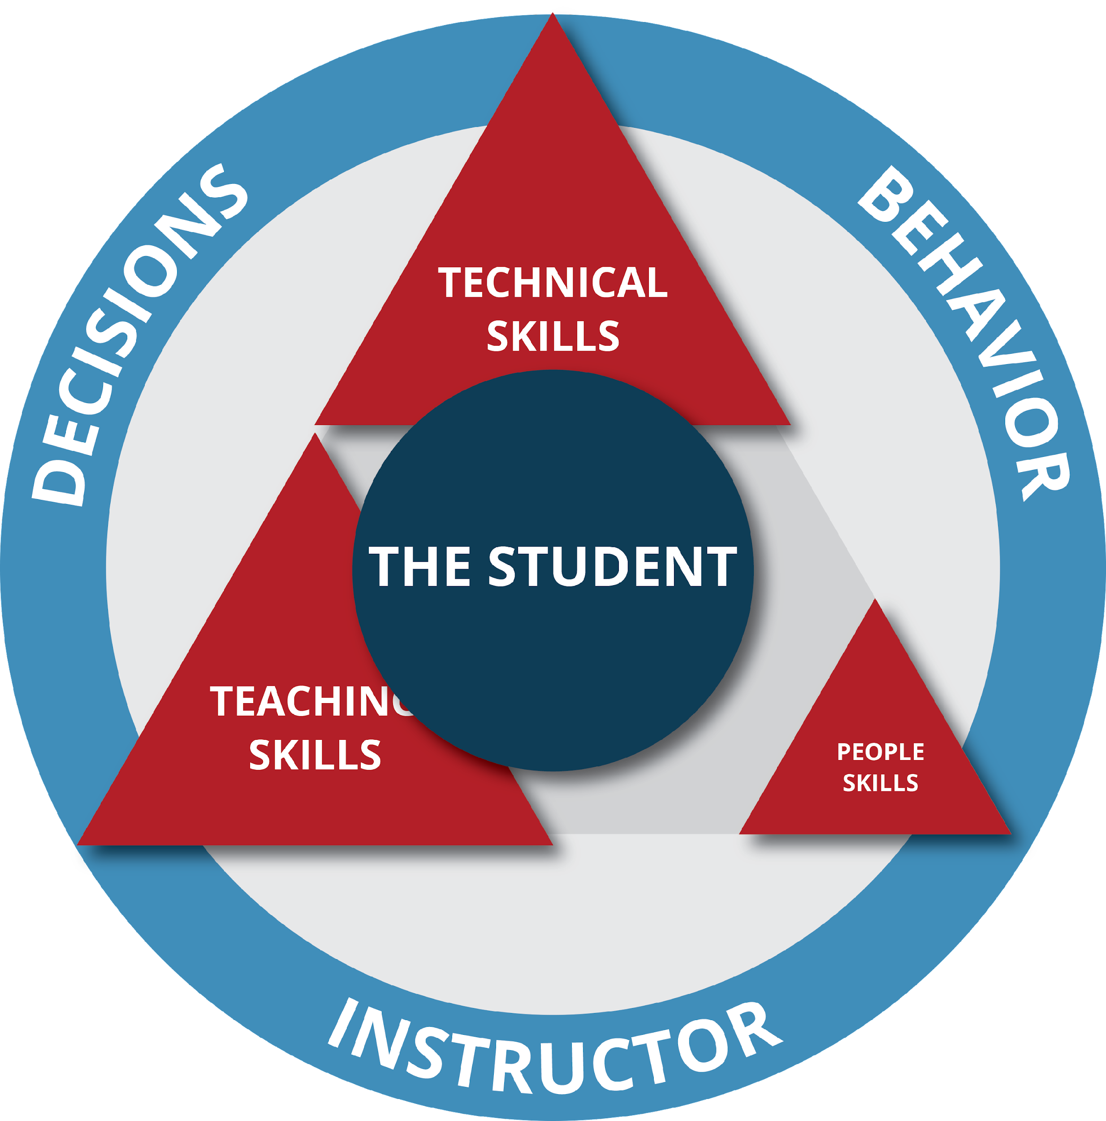
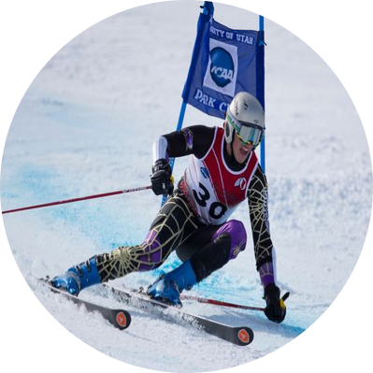
#1: SIMPLIFY INSTRUCTOR DECISIONS
The instructor adjusts the fundamentals like spokes on a wheel to keep the wheel true and the learning partnership intact

Slide 13
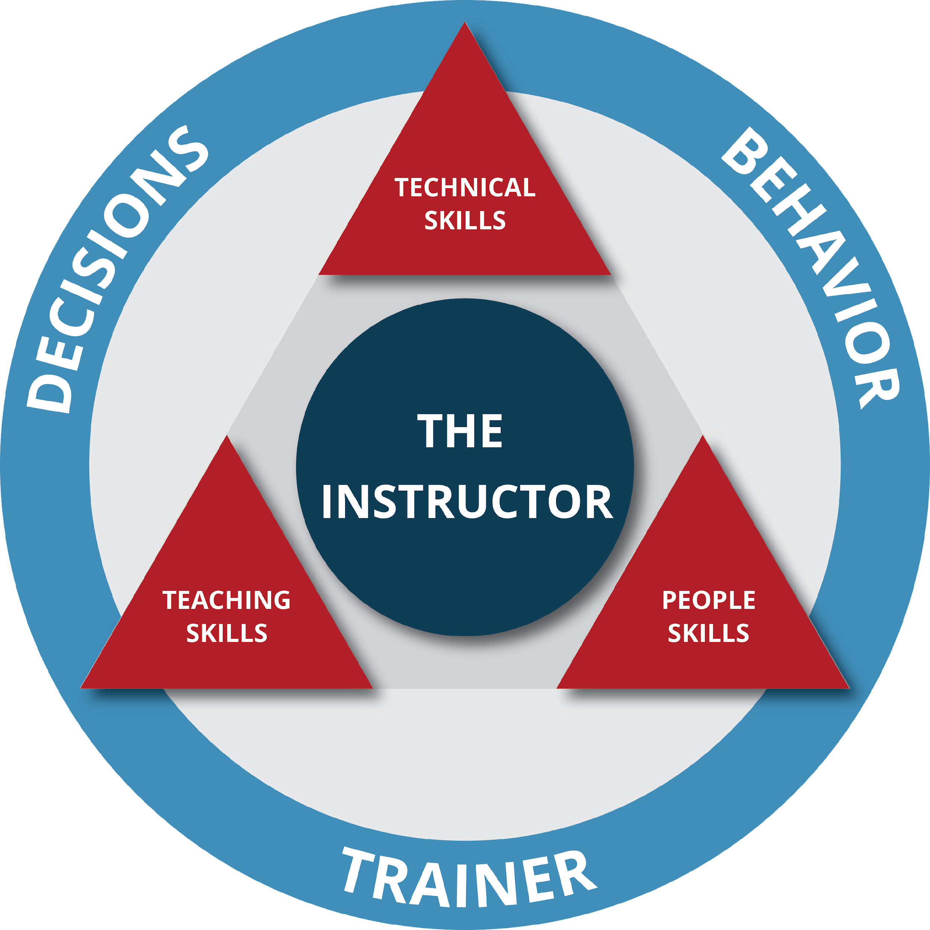
#2: SIMPLIFY PATHWAYS TO DEVELOPMENT
INSTRUCTOR DEVELOPMENT

Slide 14
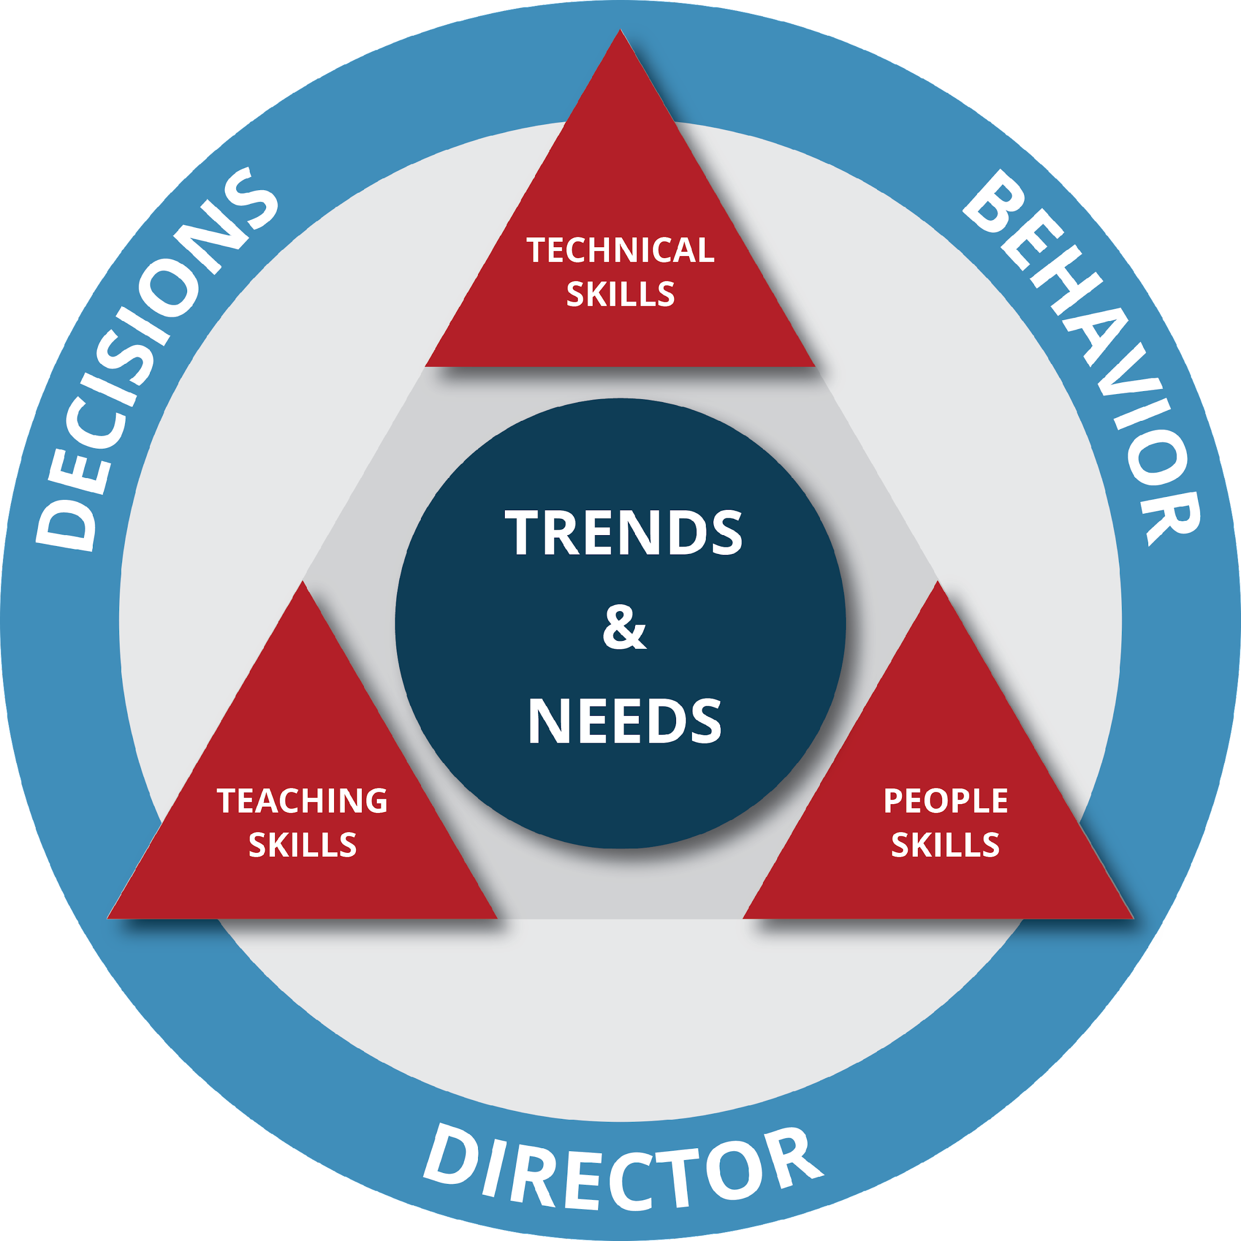
#2: SIMPLIFY PATHWAYS TO DEVELOPMENT
SCHOOL DEVELOPMENT

Slide 15
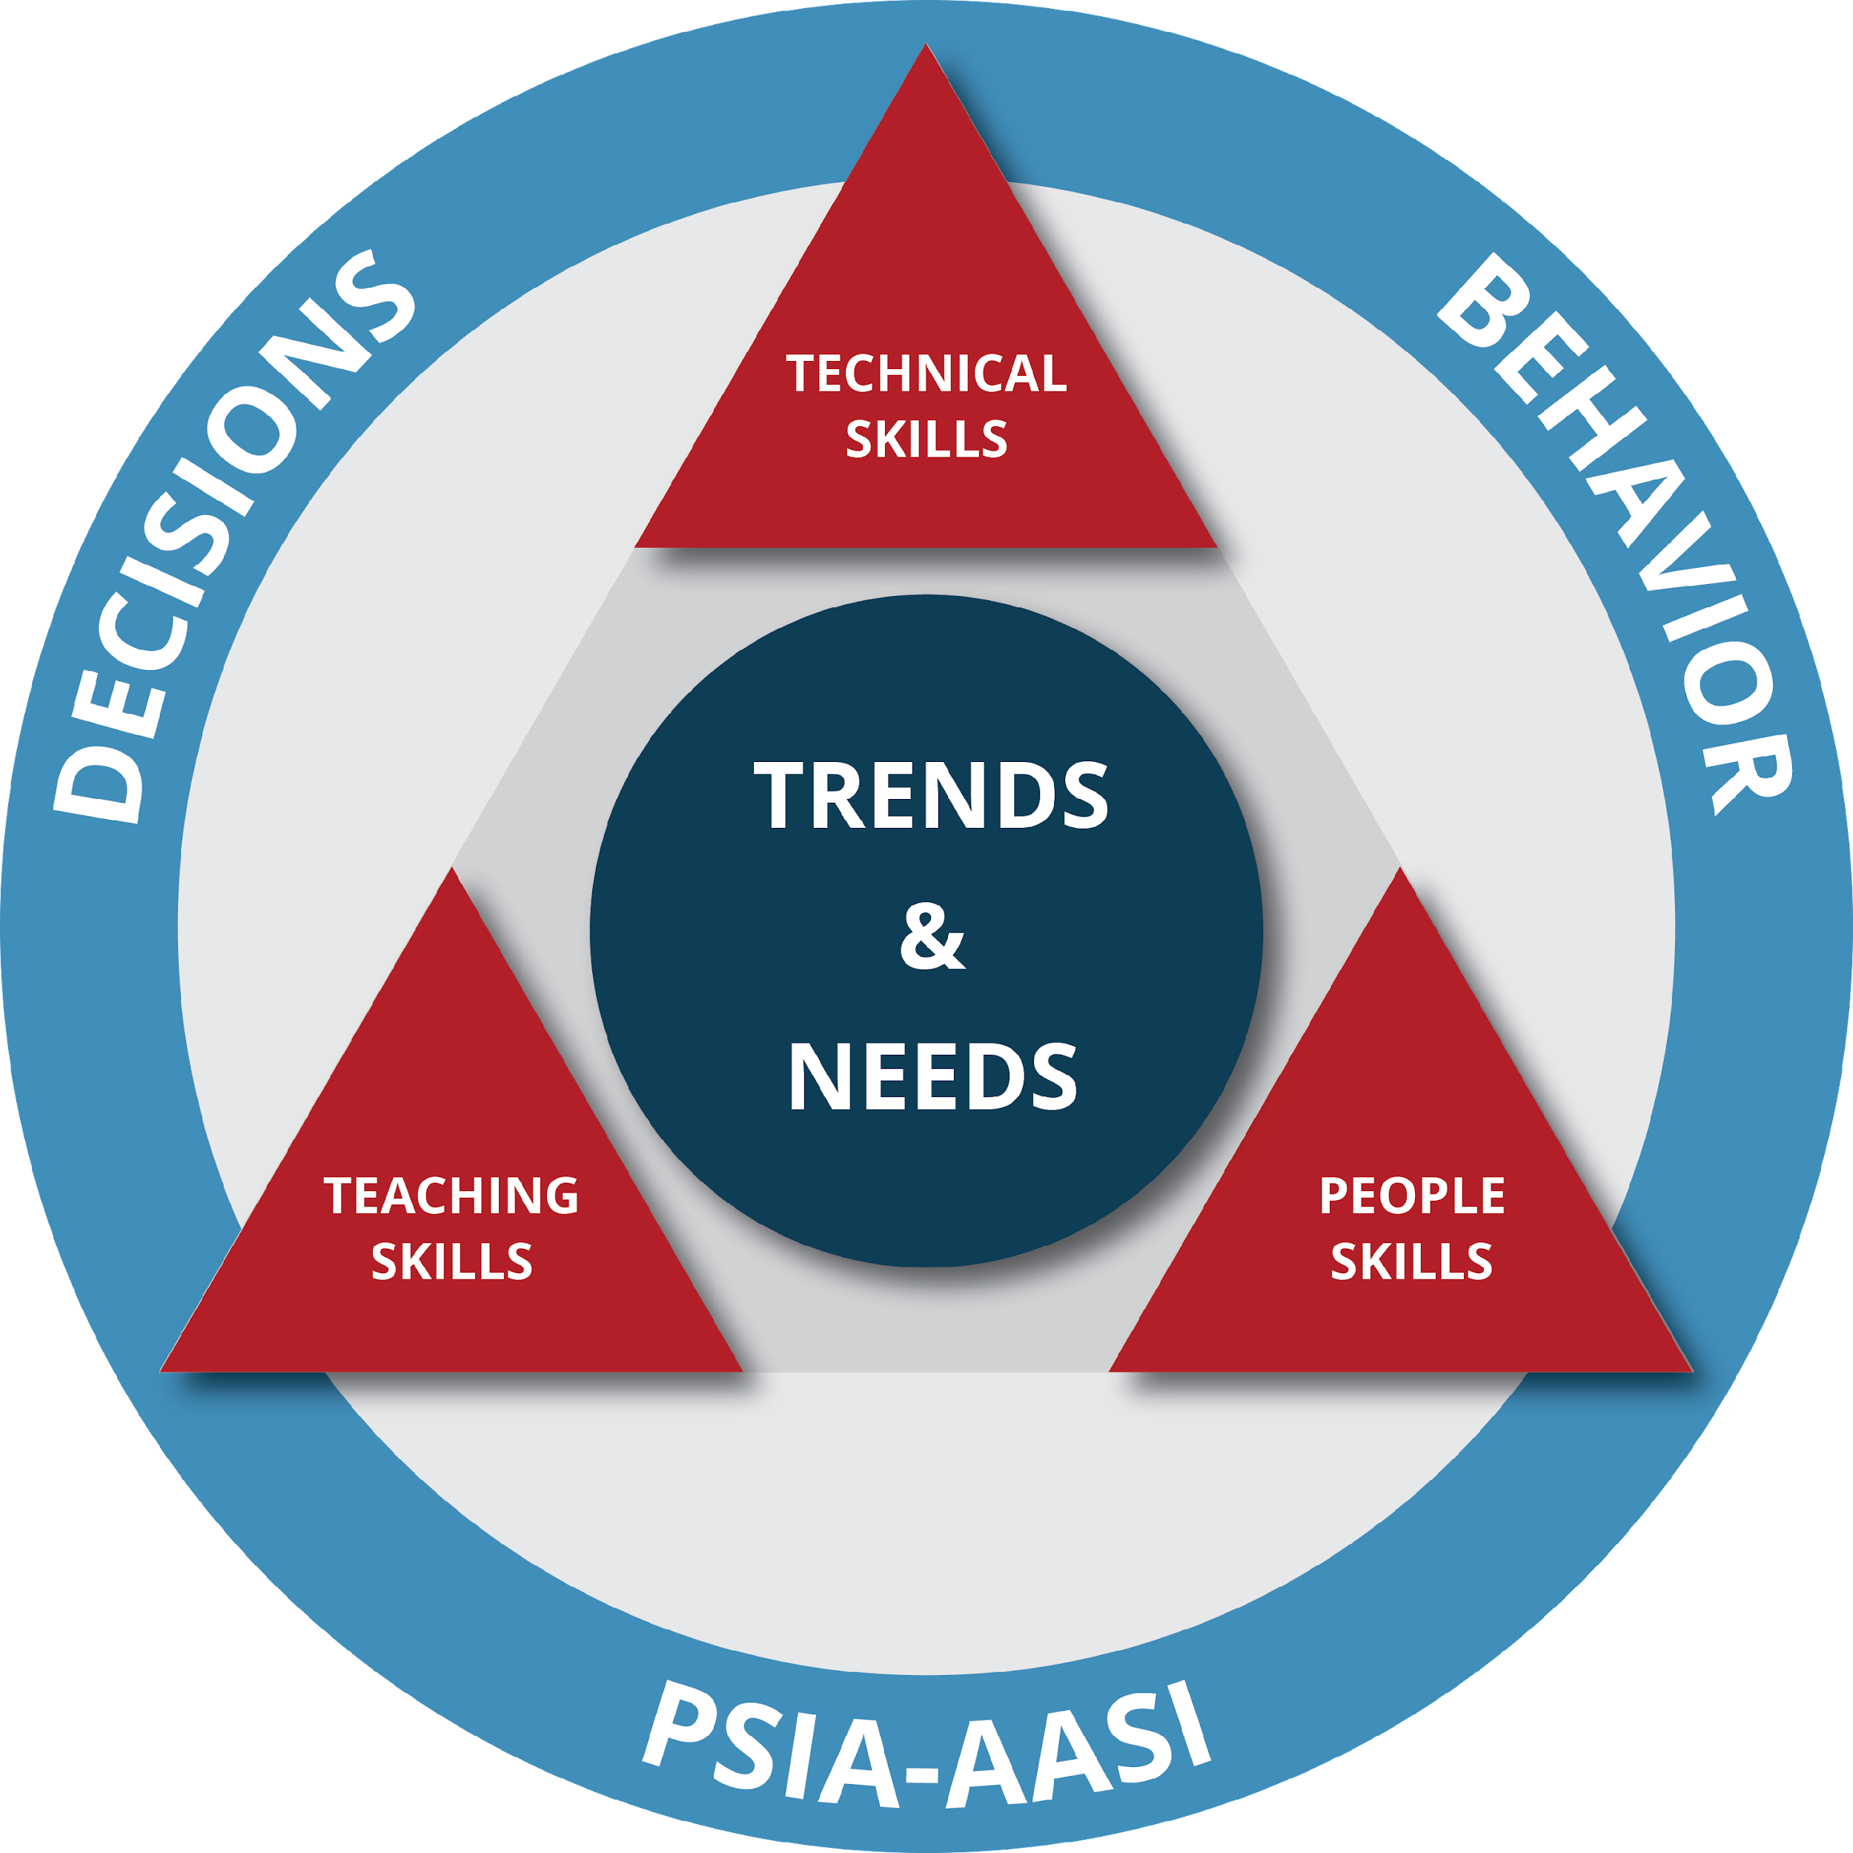
#2: SIMPLIFY PATHWAYS TO DEVELOPMENT
NATIONAL DEVELOPMENT

Slide 16
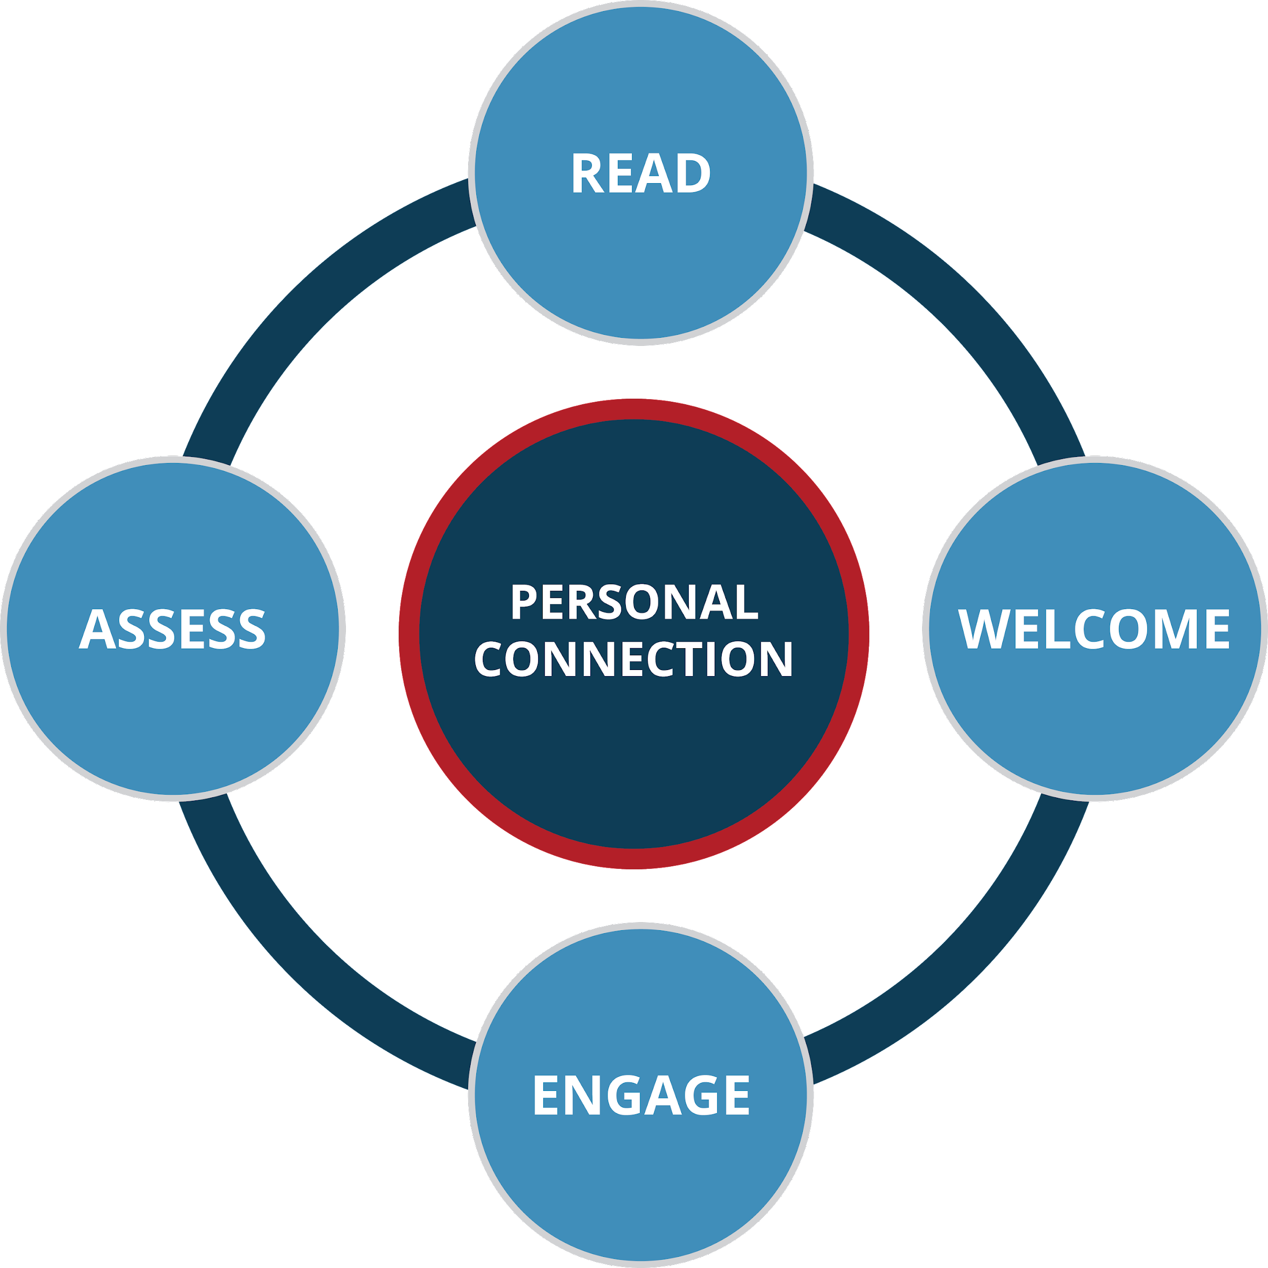
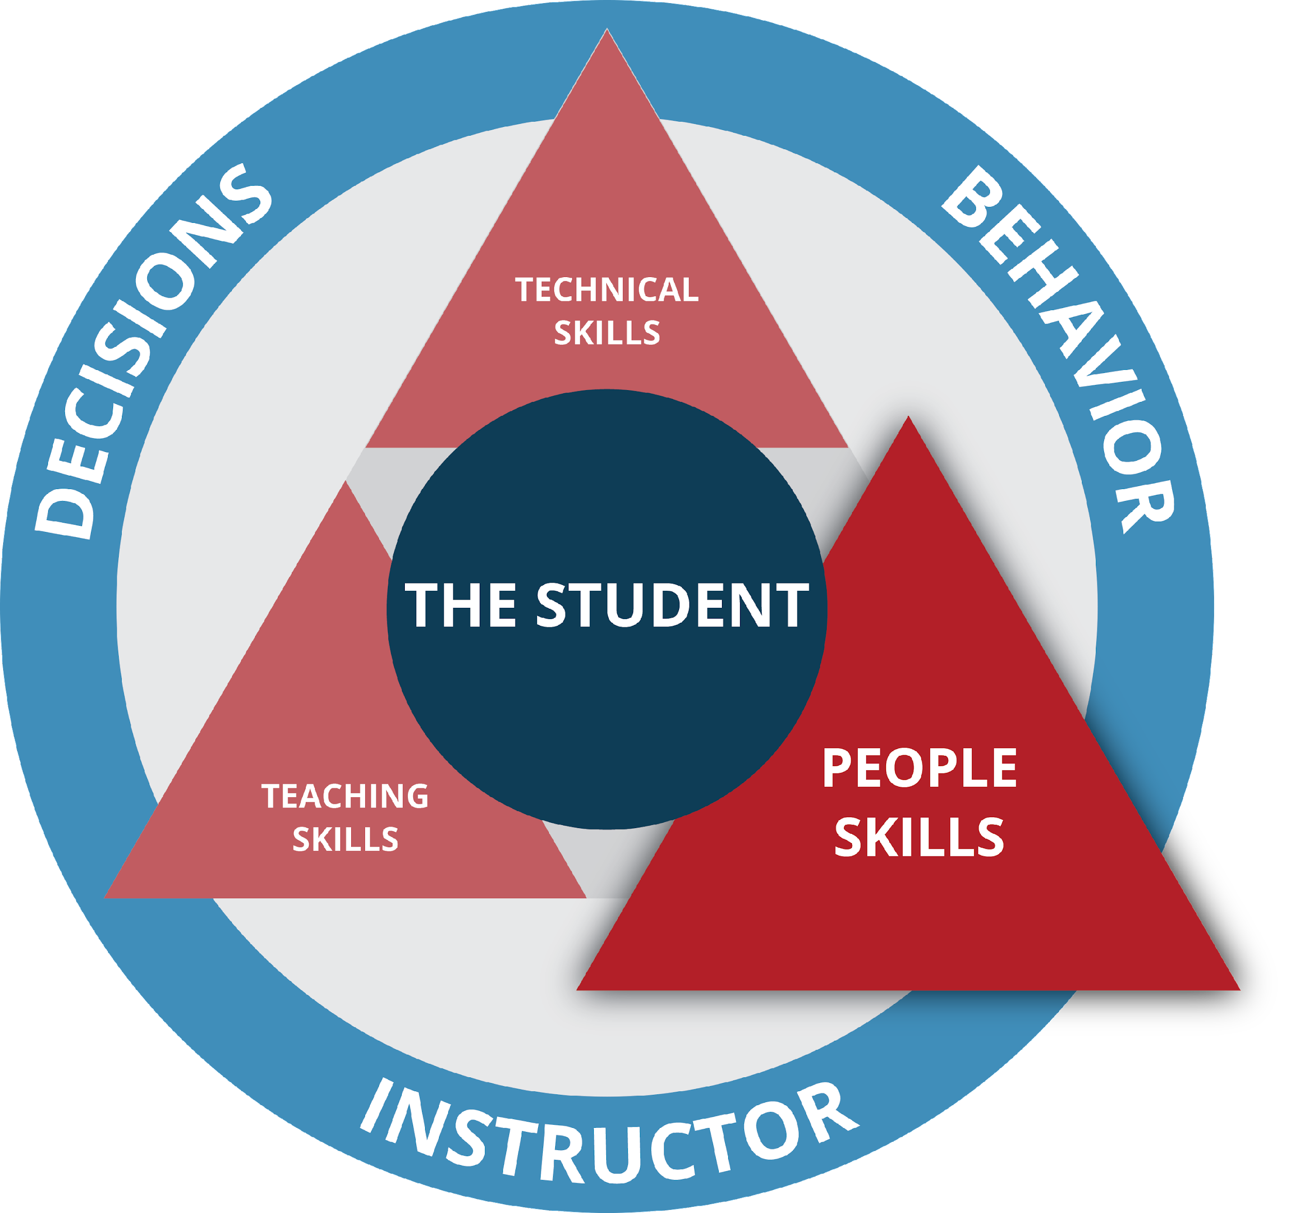
#2: SIMPLIFY PATHWAYS TO DEVELOPMENT
SNOWBOARD LEARNING CONNECTION MODEL

Slide 17
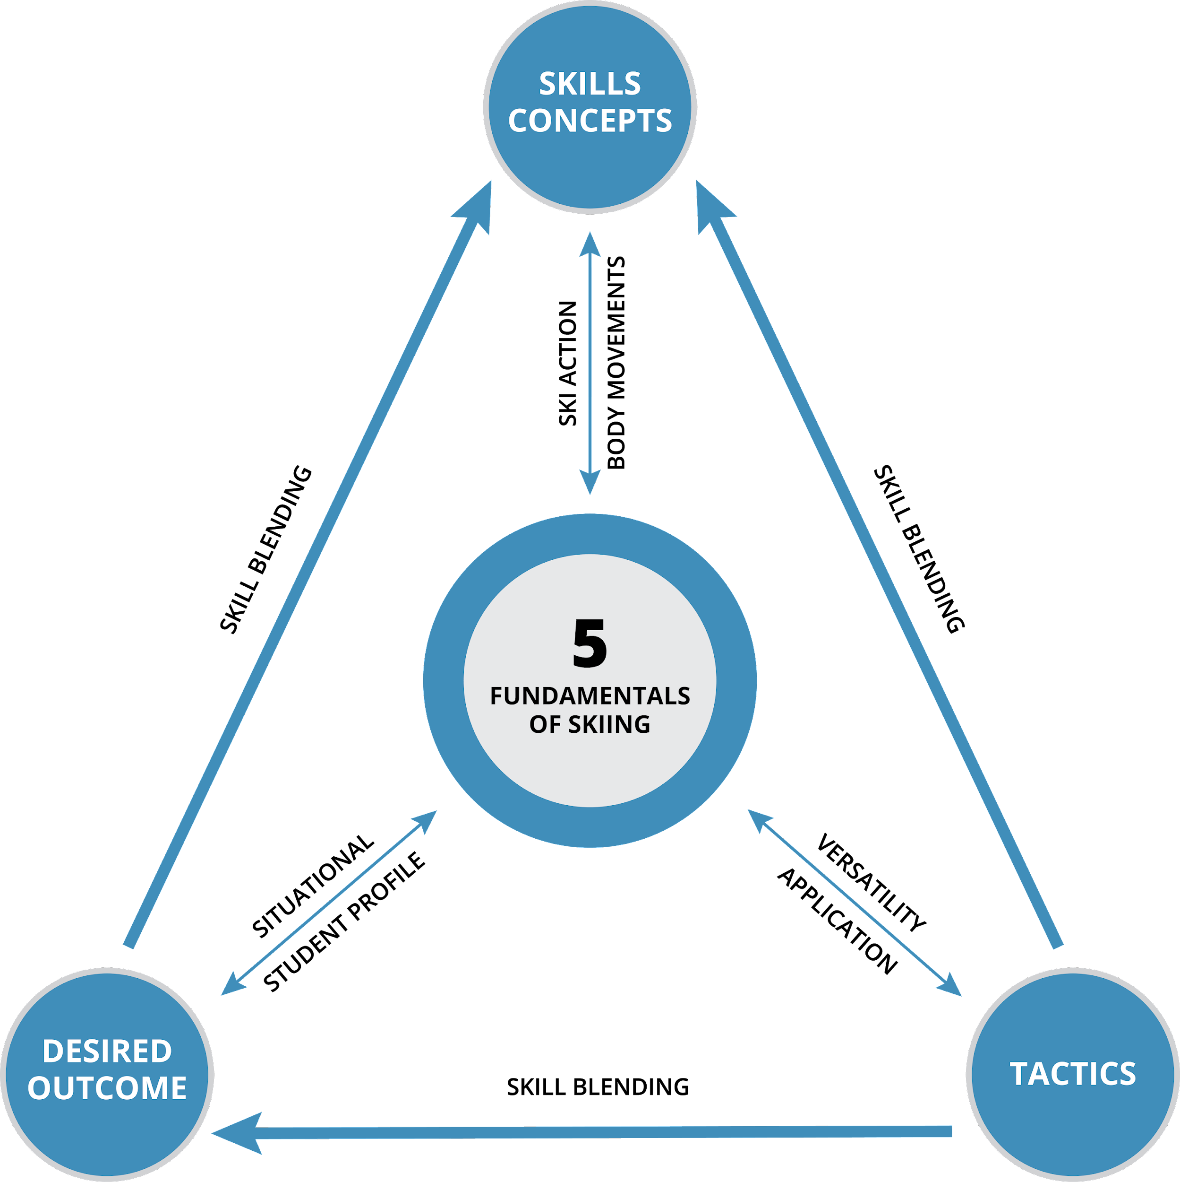
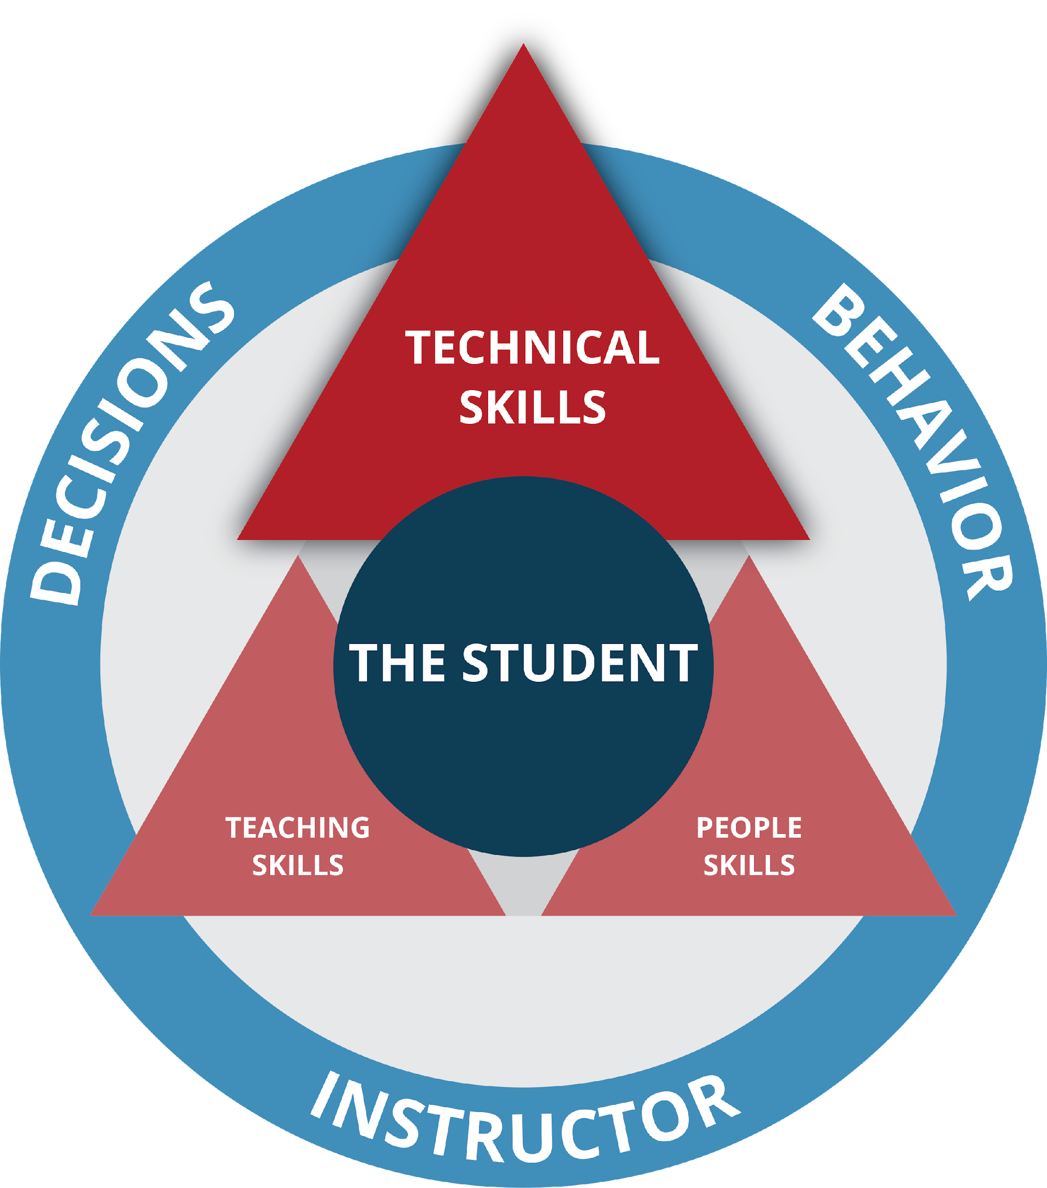
#2: SIMPLIFY PATHWAYS TO DEVELOPMENT
ALPINE SKIING FUNDAMENTALS

Slide 18
#2: SIMPLIFY PATHWAYS TO DEVELOPMENT
ADAPTING THE SKIING FUNDAMENTALS

Slide 19
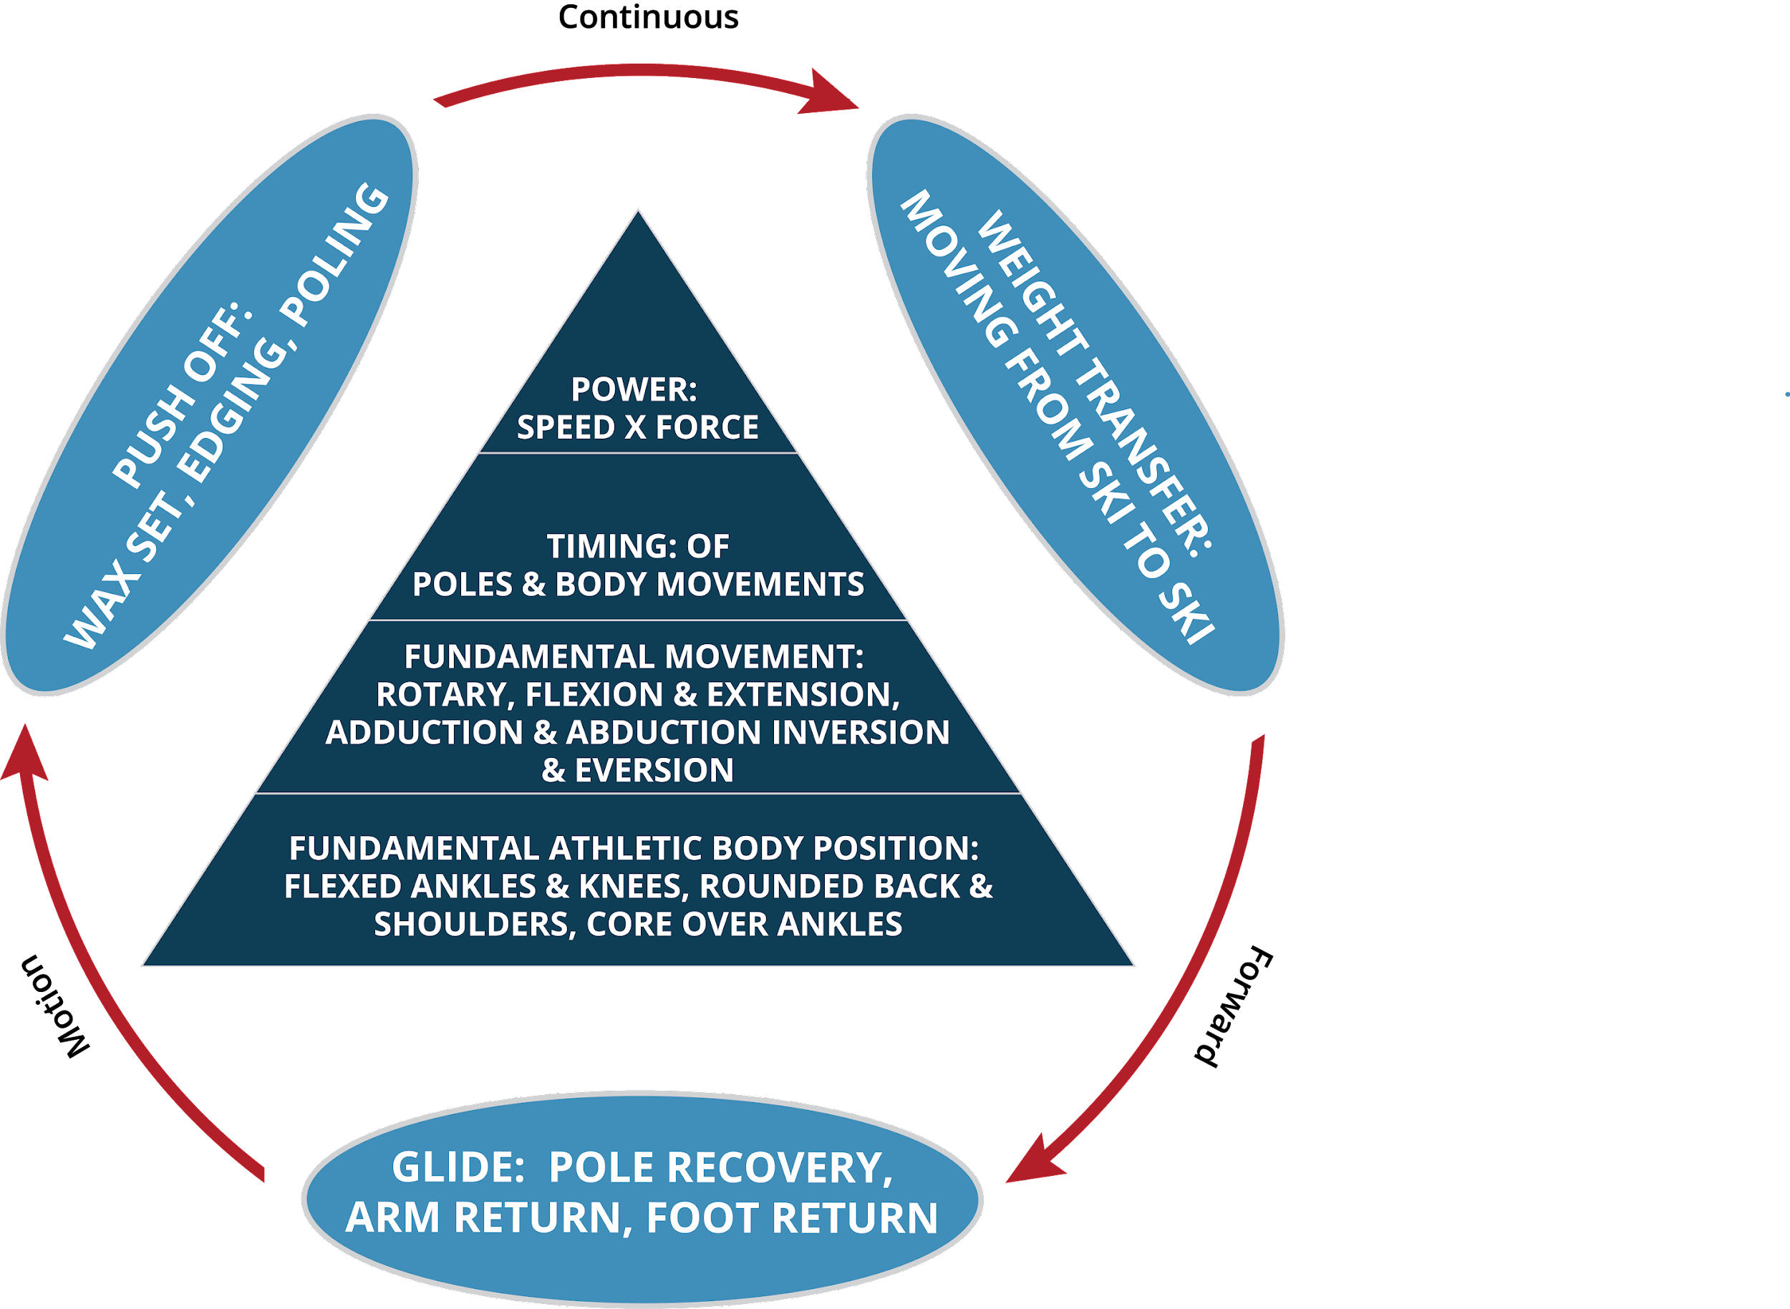
#2: SIMPLIFY PATHWAYS TO DEVELOPMENT
CROSS COUNTRY TECHNICAL MODEL

Slide 20
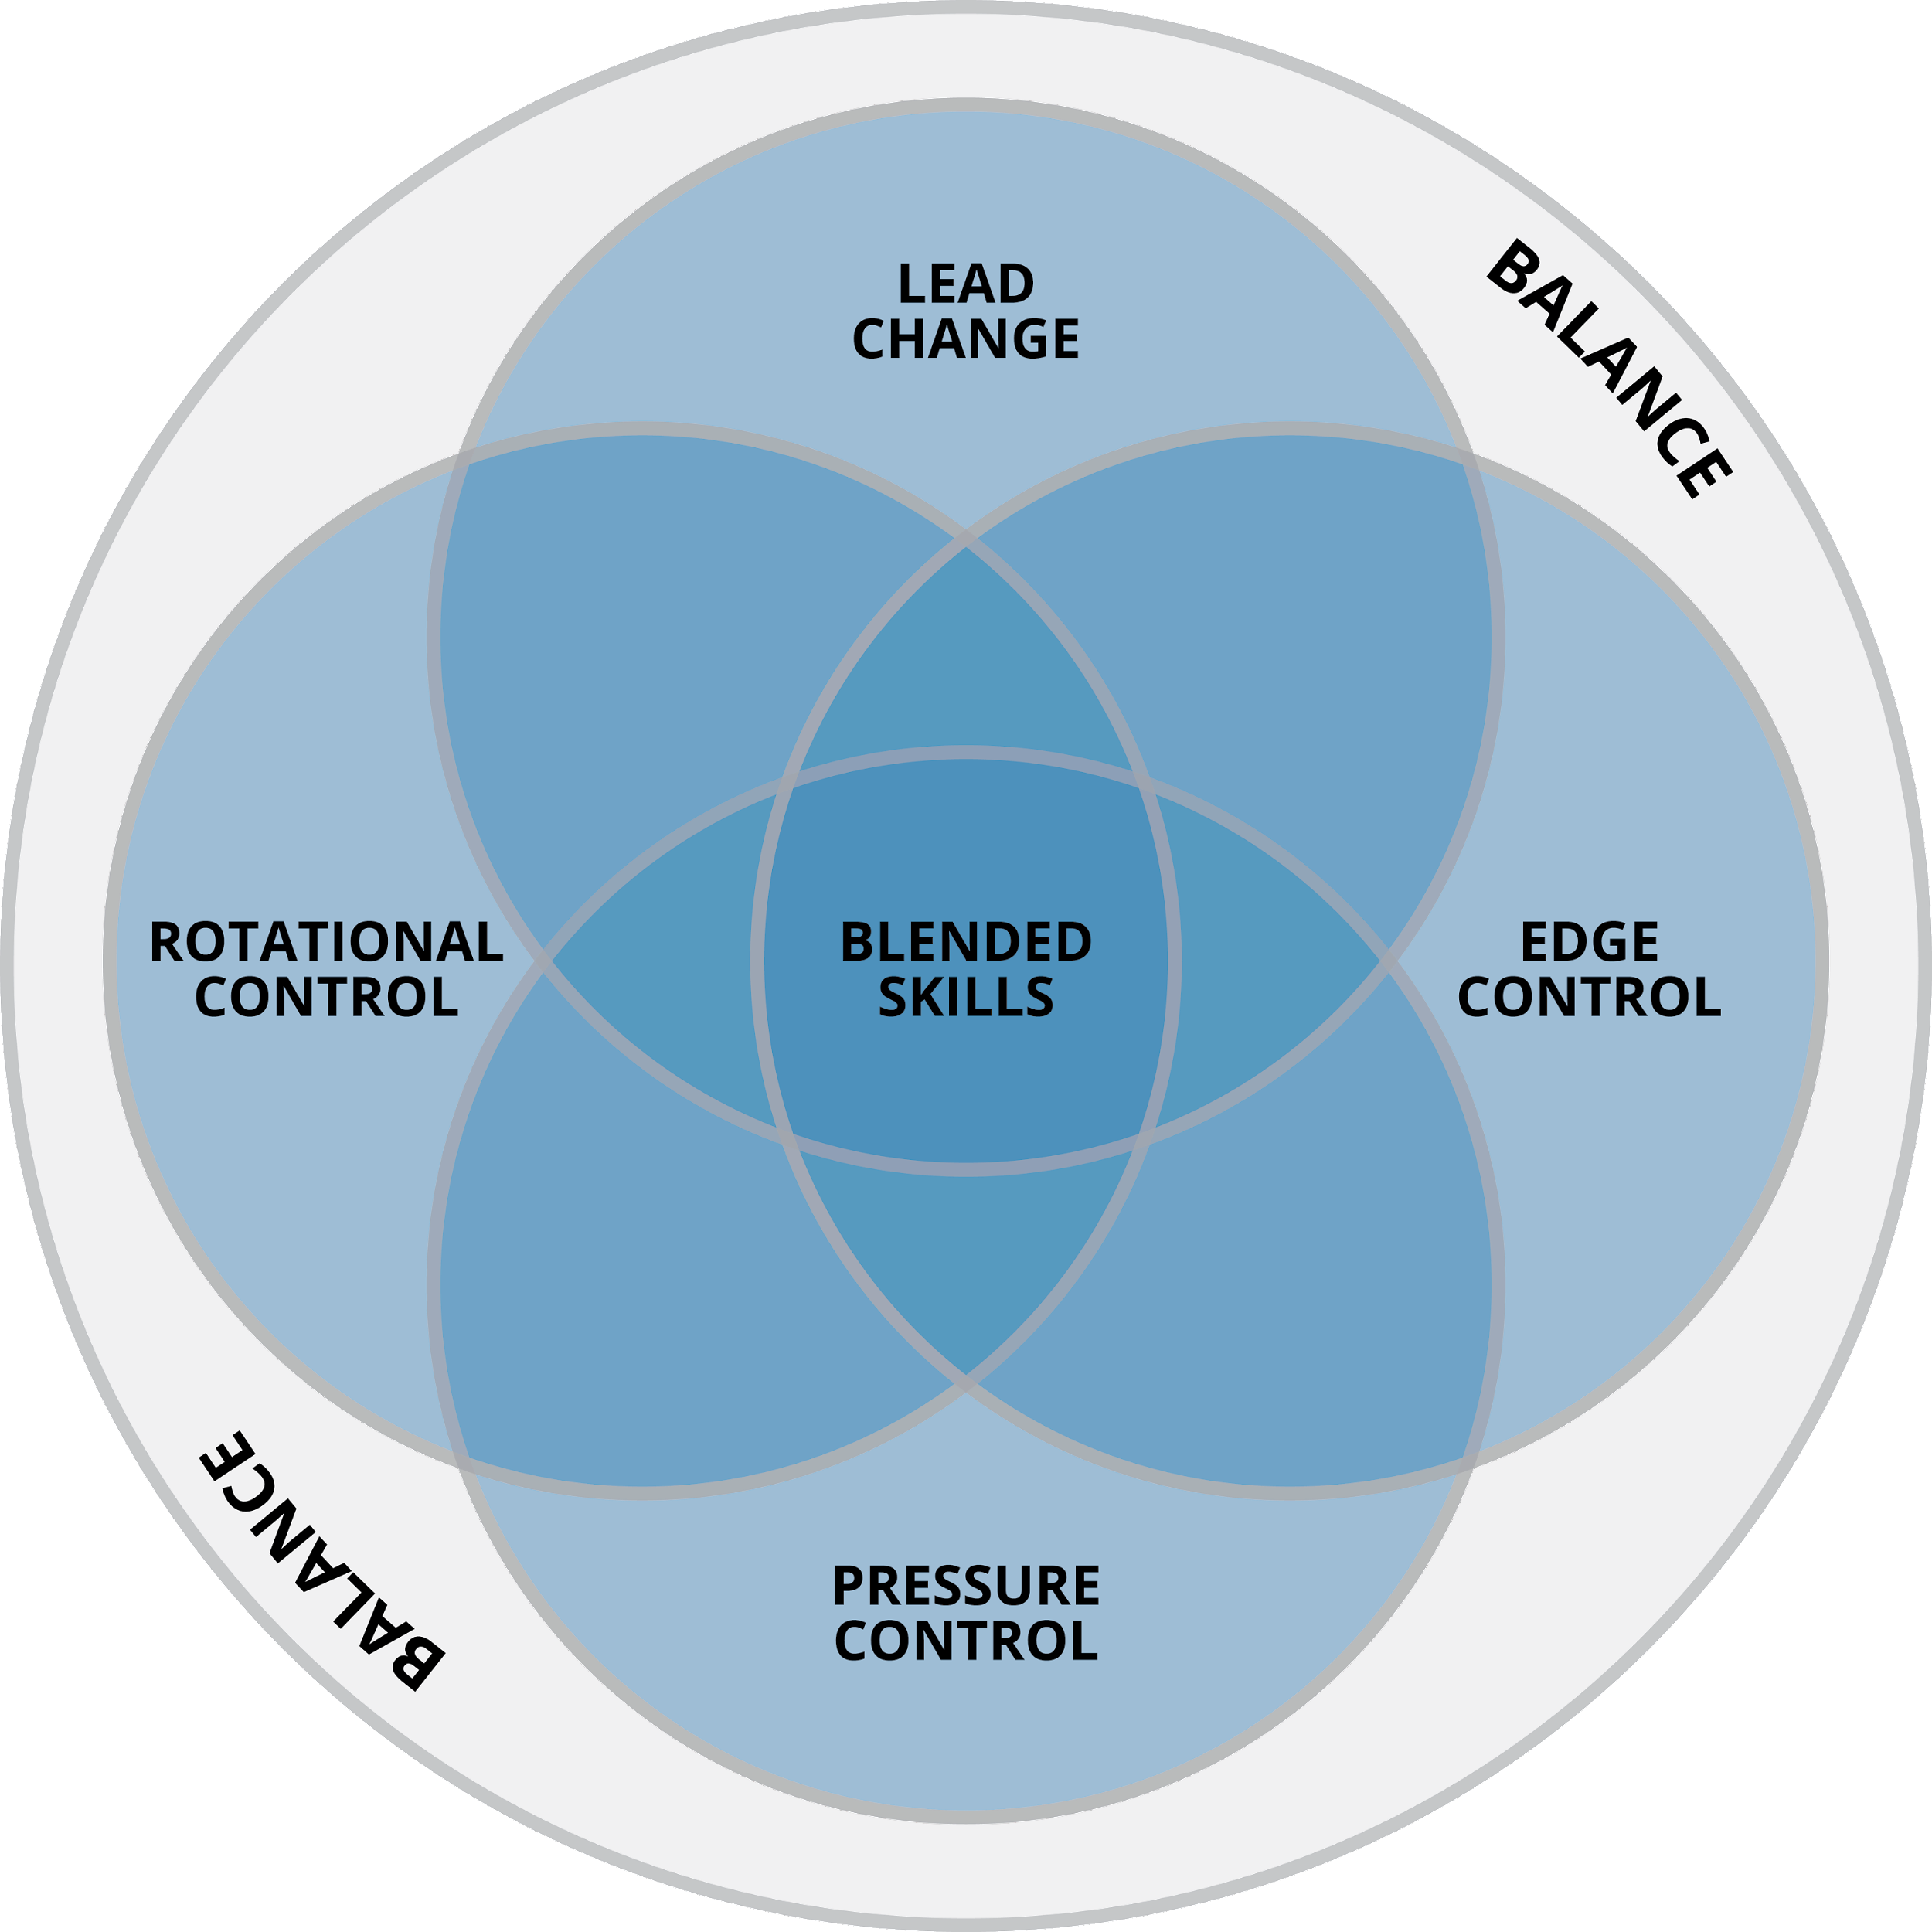
#2: SIMPLIFY PATHWAYS TO DEVELOPMENT
TELEMARK FOUR SKILLS MODEL

Slide 21
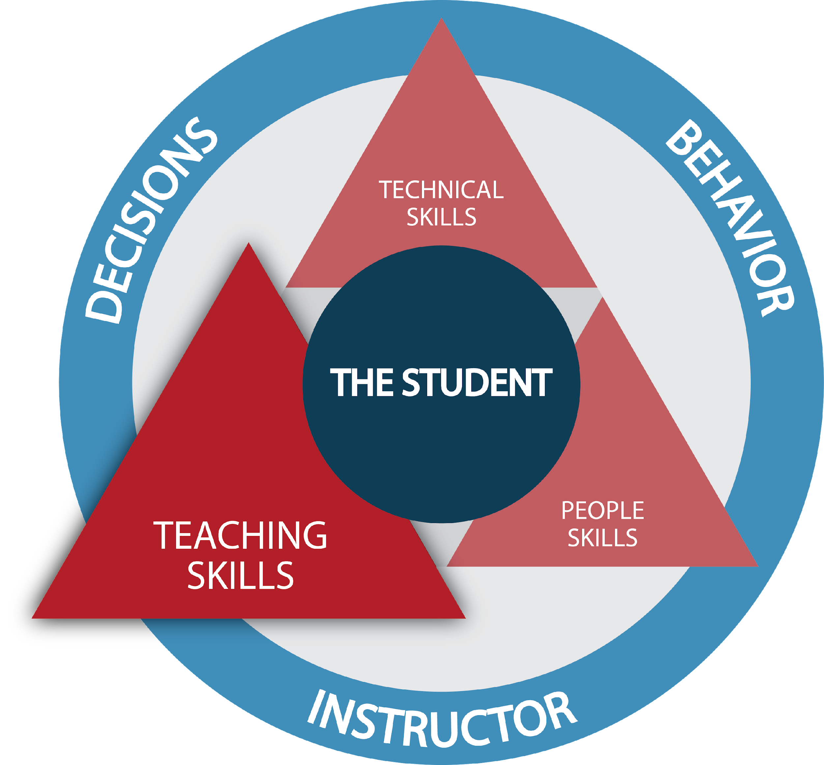
#2: SIMPLIFY PATHWAYS TO DEVELOPMENT
ROADMAP TO OUR NEW DIRECTION
WHAT ARE THE FUNDAMENTALS OF GREAT TEACHING?
OUR CORE VALUES:
STUDENT CENTERED
EXPERIENCE DRIVEN
SKILL FOCUSED

Slide 22
#3: ENHANCE OUR CONNECTION
WHETHER IT IS AT A NATIONAL LEVEL OR IN AN INDIVIDUAL LESSON, OUR GOAL REMAINS THE SAME – SIMPLIFY TO ENHANCE THE CONNECTION.

Slide 23
THESNOWPROS.ORG

