Slide 1
DEFINING THE FUNDAMENTALS OF TEACHING| INTERSKI 2015

Slide 2
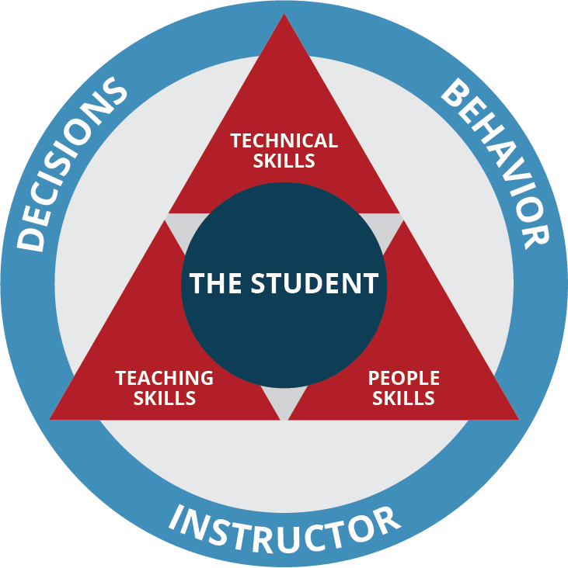
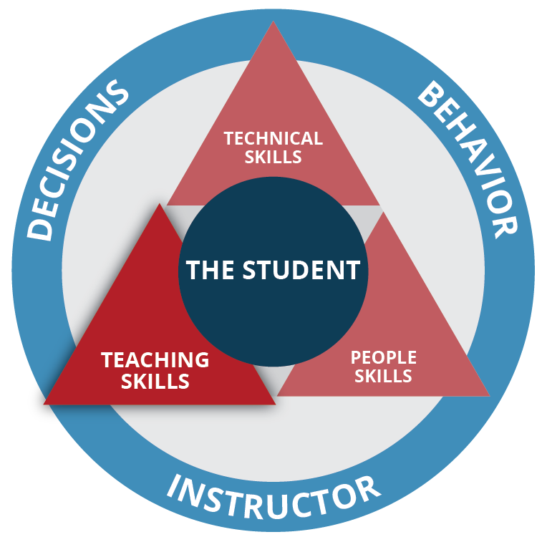
Notes:
Jon
Many of you have seen this model
Explain for those who are seeing it for the first time – Describe it as an organic framework for gathering and categorizing information
So far our team has presented where we were (People) – Where we are (Technical) – Where we are going (Teaching)
Mission to simplify and distill to the fundamental traits ond core values of great teaching
As that this is where we are going we do not have all the answers yet. What we have is a core set of values that we would like to share with you.
Let’s set some ground rules
This will be an interactive workshop and an opportunity for all of us to share a few ideas on great teaching.

Slide 3
The goal of teaching:
Learning:
A permanent or near permeant change in understanding and behavior
Notes:
Jon
Define the goal of teaching = Learning
For this we need to define learning so that we can recognized when it has occurred
Define Learning
From here we need to briefly discuss the process learning

Slide 4
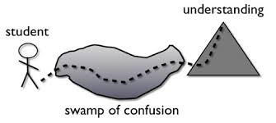
LEARNING IS RESOLVED CONFUSION…
Notes:
Jon
What is not confusing? …everything you already understand
What is confusing? …everything you do not understand.
For learning to happen in our students we must accept that we will lead them to degree of confusion
Our job is not to make things confusing but, we are accepting that the learning process involves a degree of confusion
We, as instructors, design a learning environment that helps the student work through some degree of confusion to create clarity
We think of great teachers as master designers of the learning environment
In other words....Great teachers strive to design an environment that safely challenges the student with something they do not fully understand and guide them through the “swamp” to discover clear and actionable learning (change in understanding that effects behavior)

Slide 5
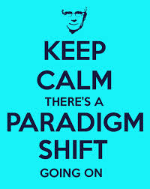
Changing the Paradigm of Teaching
Facilitator of Learning
Presenter of information
Notes:
Dave
We are shifting the paradigm of teaching from “presenter of information to facilitator of learning”
The paradigm shift is in the mindset and behavior of the teacher.

Slide 6

Core Values of the Learning Environment
Student Centered
Experience Driven
Skill Focused
Notes:
Dave
we believe that a great learning environment always exemplifies three core values.
Student Centered:
Meeting the students needs and wants
Understanding how the student understands and processes information
Keeping the process intentional
Constantly including the student in the direction of the learning segment and giving control of the environment to the student
The student should be able to control:
Pacing
When and what type of feedback is received
When new information is added
How long of a practice/adventure session needs to be
Direction
****JON
Experience Driven:
We have all experienced the moment when learning occurred, it is the light bulb moment, the moment when everything changed and you finally “got it” This is the moment when the student discovers the solution to the problem.
This happens with the help of the teacher through guidance but, the key is, that this, the discovery process, is a process that happens entirely within the student. Learning is a process that happen in the student
This happens through perceiving and processing our experiences. This is the same regardless of what we want to learn in life.
These experiences may involve tasks, direct coaching and feedback and other classic methods of instruction or, they may involve playful exploration or, a combination of both.
Regardless it is the EXPERIENCE that the student has that leads then to discover the learning, NOT the dissemination of information by the instructor
Therefore, the experience drives the learning environment and must be flexible and meet the changing needs of the student.
****DAVE
Skill Focused:
Neither the teacher nor the student is not the focus
The desired student outcome is the focus.
The skill to be worked on will be derived from the fundamentals
The fundamentals are broken down to achievable bite size chunks
Changes that are made are intentional to continue the learning process

Slide 7
Student Centered
Experience Driven
Skill Focused
What are you doing when these concepts are present and working?
What are the simplest, observable and measurable forms of these traits?
Notes:
Dave
Break audience into smaller groups
Have a PSIA team member in each small group to facilitate
Ask the question and allow for 5 – 7 minutes of conversation

Slide 8
Identifying Teaching Fundamentals
Notes:
Jon/Dave
Fundamental traits are what we are looking for. We define “Fundamental” as something that is always present, regardless of level
Our goal in our future process is to identify simple and replicable fundamentals in teaching that are observable and measurable
We have core values that we can recognize and to which the fundamentals must adhere
We have witnessed new instructors create great learning environments and and seasoned instructors present and teach while no learning occurs.
The question we are striving to answer is: What are the common actions, regardless of level that creates and exceptional learning environment that exemplifies the values:
Student Centered
Experience Driven
Skill Focused
With this question answered we can plant the seed of exceptional teaching in the beginning of each instructors career.

Slide 9

TO ACCESS MANUALS
1. App store: Search “Snow Pro Library”
2. Click “member login” & add: Username: USA
  Password: Interski2015
3. Enjoy!

