Slide 1
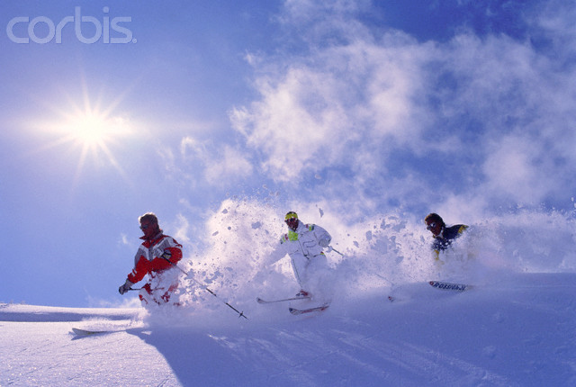

A Profession in Transition
Horst Abraham 2013
2013 RM-Fall Fandango

Slide 2
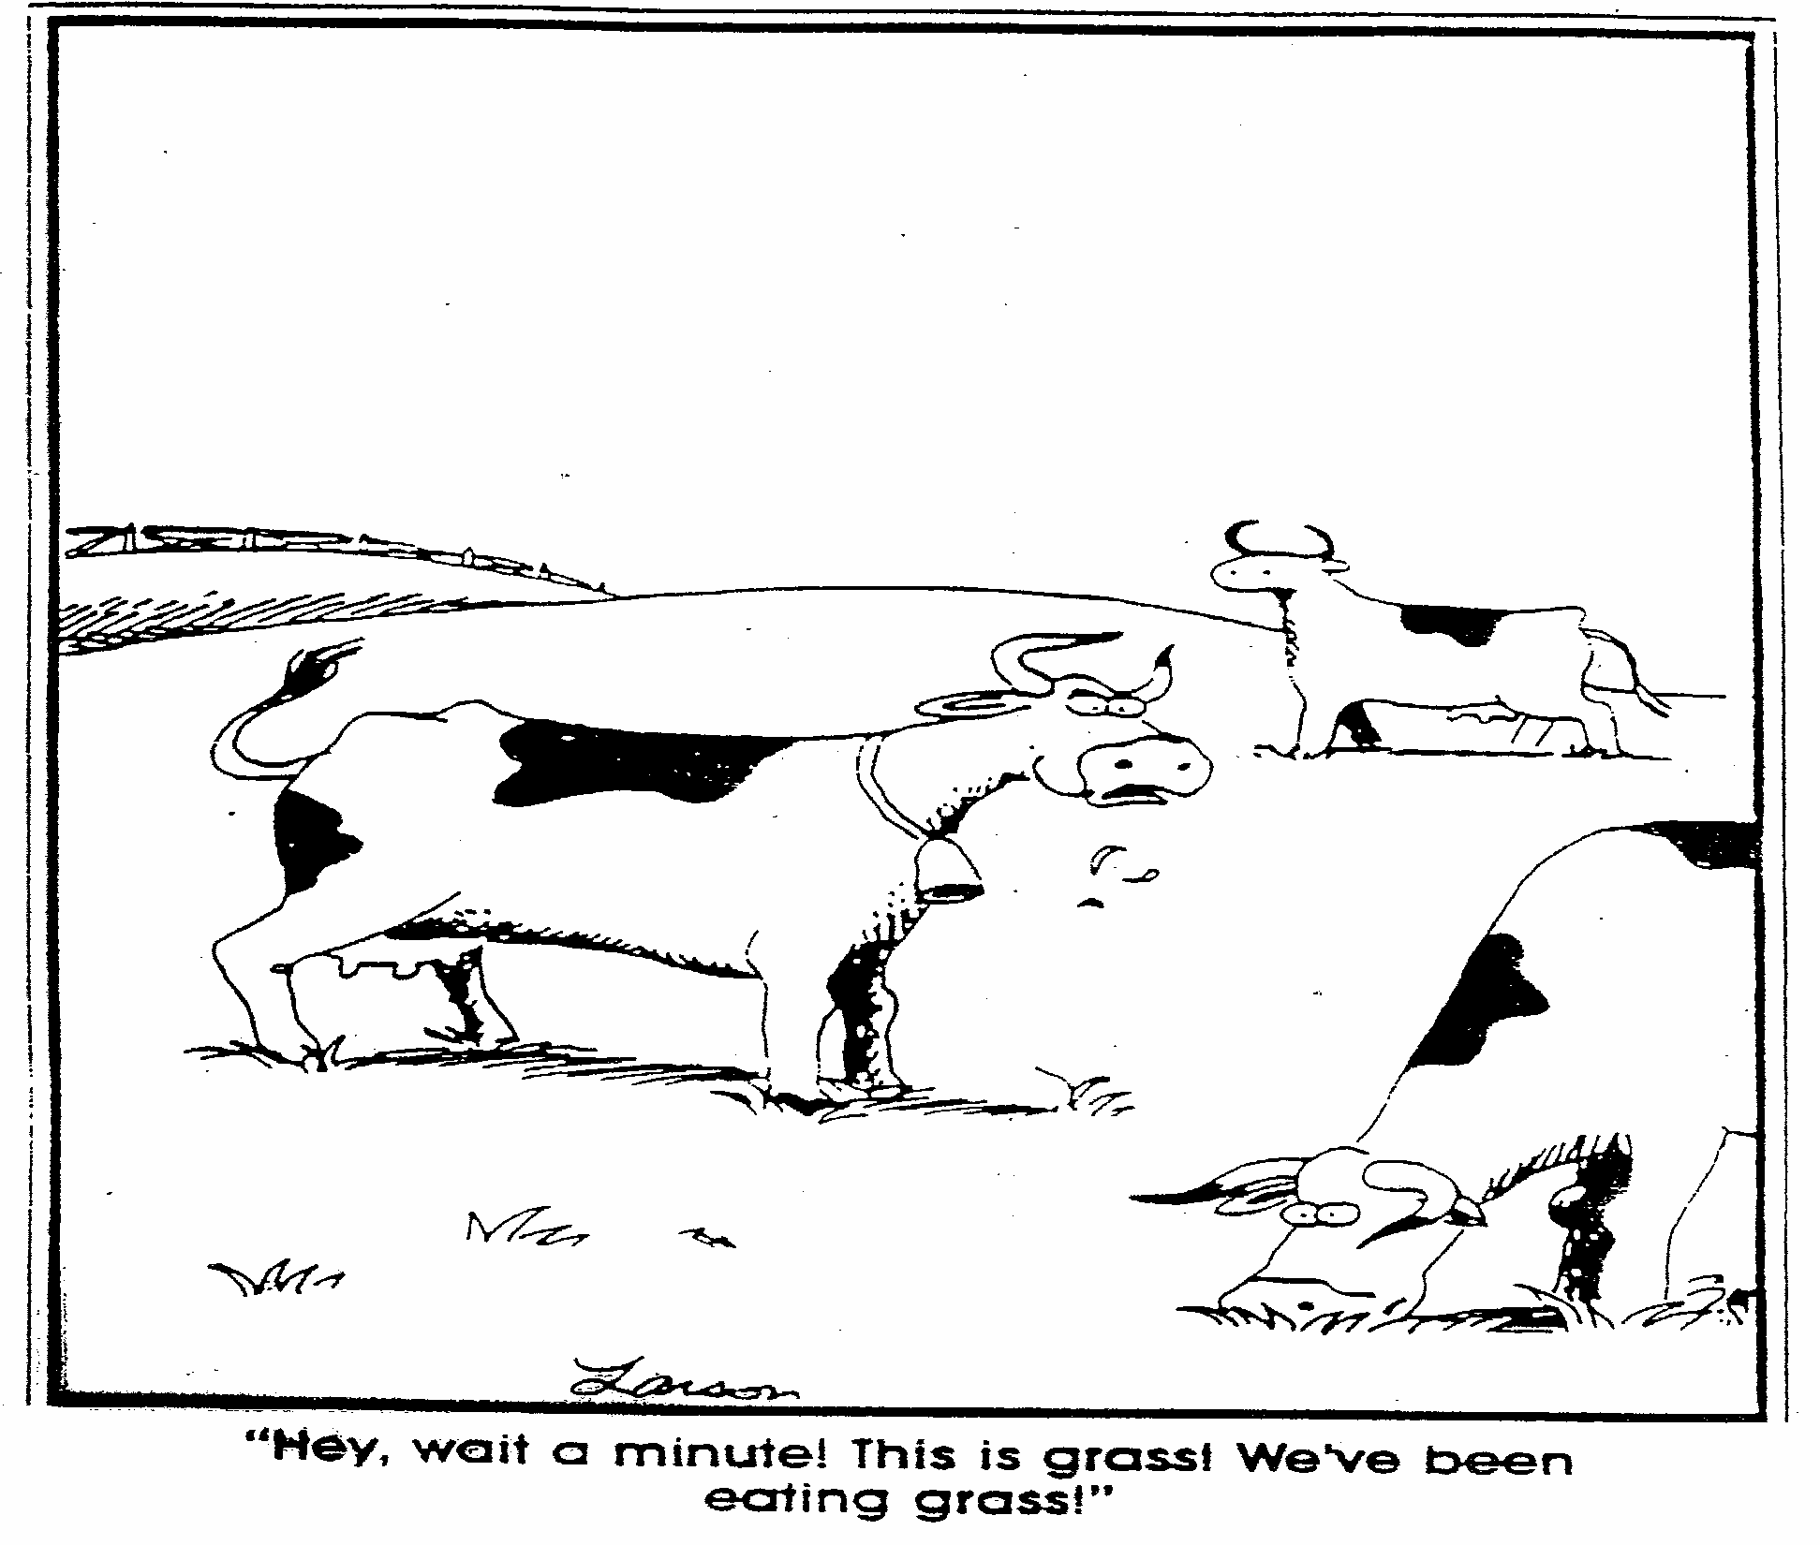
“Hey, wait a minute! This is grass!
We’ve been eating grass!”!”

Slide 3
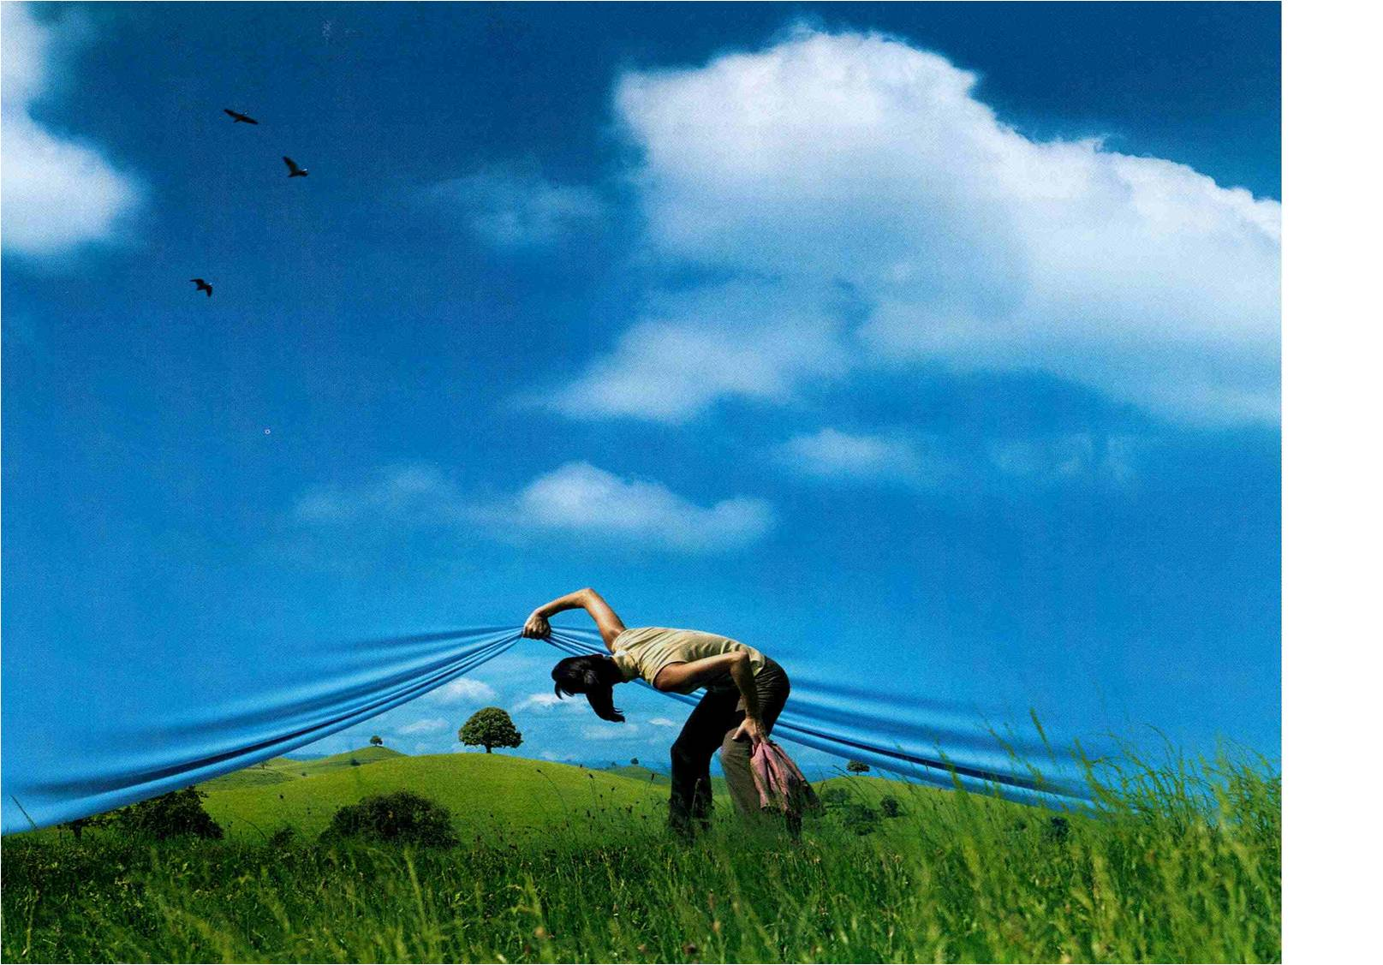
We learn from our experiences…..
CONTEXT:
The Boomer market is shrinking
The imbedded market is flat
New markets remain largely untapped
Areas compete for a greater share of a shrinking market
Winter sport image has gone X-treme
Hi-Tech gear makes learning sports easier
The business world that ‘feeds’ us is undergoing seismic changes
Where does that leave our profession?

Slide 4
10 provocative ‘messages I want to leave you with…
Technique gets in the way of Experiential Learning
All ride sports are ‘Open Skill’ sports
Replace technique with play & experimentation
Learning trumps knowing as a core capacity
Instructor as ‘Designer’
Replace ED/EC with ‘Best Self’-teaching
‘Active Learning’ = ‘Task-Community-Support’
Multiple-person-lessons trump Single-person-lessons
Hi – Positive – Energy = ‘Heliotropic Effect’
Switch from ‘Movement Analysis’ to ‘Situation Analysis’
an

Slide 5
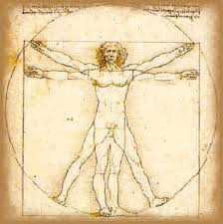
POLY-MAN
Instructors traditional questions:
What?
How?
Unasked Questions:
Why?
Who?
We must find an approach to instructing that respects the diversity of students
AND
instructors!
Algorithmic methodology cannot accomplish that.

Slide 6

We learn from our Experiences……
….suggesting ‘Active Learning’.

Slide 7
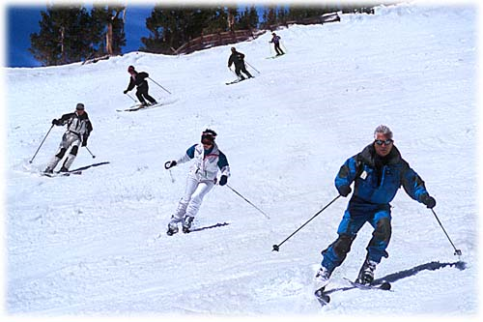
What do you see?

Slide 8
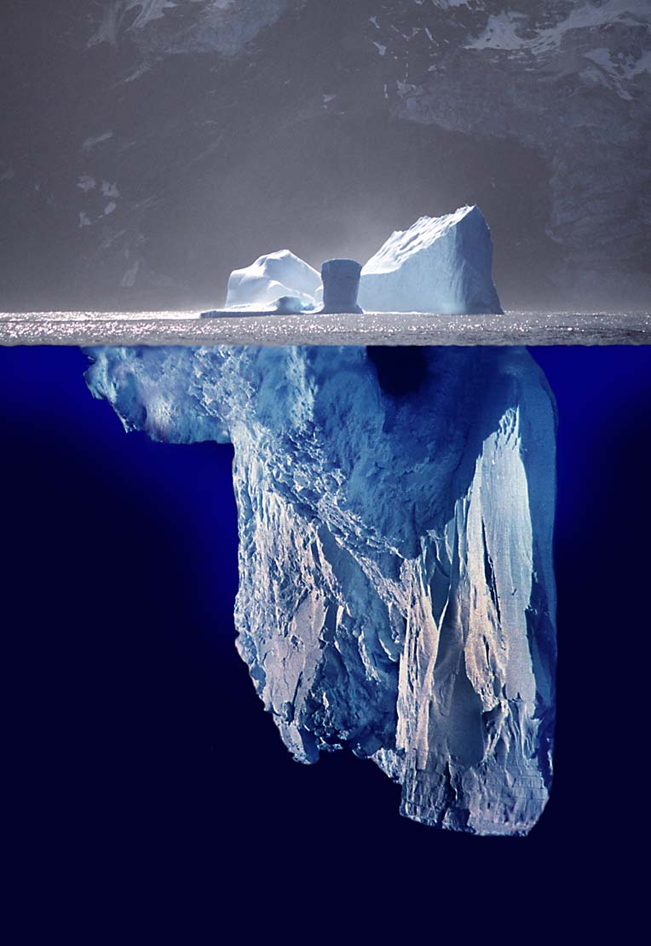
Iceberg model
Behavior
Technique
Experience
Behaviors
Thoughts
Perceptions
Feelings
Beliefs
Assumptions

Slide 9
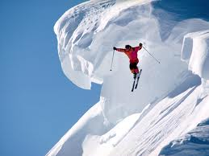
Parker Palmer
“Technique is used until
the real teacher shows up”.
P. Palmer
Notes:
Fear and Thrill-Factors at work

Slide 10

Closed Skills: Few if any variables - stable environment
* Repetition / Sameness / Efficiency
* Training (education)
Open Skills: Many and continuous variables
  Changing environment requires (continuous) adaptation
  Perceptual skill development is key
  Concept of ‘Limited Capacity’ applies
  Collaborative dialogue is an integral part of the methodology
  Some of the most important learning cannot be taught

Slide 11
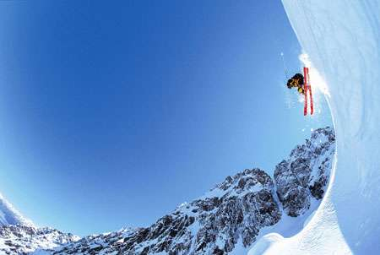
People Generally Remember…..
10% of what they READ
20% of what they HEAR
30% of what they SEE
50% of what they SEE and HEAR
70% of what they SAY or WRITE
90% of what they DO!
Exercise:
What are the instructional implications of the above?

Slide 12
The Learning Pyramid
What we remember after two weeks Engagement with what we have learned
Reading
Listening
Speaking
Thinking out loud 70%
Discussing
Saying & Doing
Teaching
10%
20%
Passive Learning
Seeing & Hearing
Listening & watching
50%
70 %
Active Learning
90 %

Slide 13
Three Worlds of the Learner
Feedback Feedback
Sensory Interface
I See
I Hear
I Feel
Outside World
Environment
Task
Information
Expectations
Inside World
Emotions
Perceiving
Knowing/Processing
Sense making

Slide 14
Hierarchical Model
A prescription for ‘passive learning’
---------------------------
Expert
------------------
Student
Riding
The ‘truth’ is studied, reduced and objectified by the instructor.
By doing that, the discovery opportunity is ‘stolen’ from the learner, leaving the student in a ‘passive learning’ mode.

Slide 15
Learning Dichotomy
Technique focused learning
Narrow performance boundaries generate
performance anxiety
Errors & fear of errors trigger the ‘Cortisol Effect’
‘Selective Attention’ creates competing priorities – task /awareness of what is happening - Selective Attention
One skill @ time (!?) -
’

Slide 16
Active-Learning- Alternative
Play and Experimentation
Soft focus on ‘task’
Emphasis on play & experimentation = productive energy
Increased risk taking
Increased ownership
Generates FLOW
Self generated insight and BFOs generate ‘learning addiction’

Slide 17
Building the ‘Learning Community’
Task-Community-Support
TASK drives learning Challenge motivates
Experience 2
Experience 1
Experience
3
Community
When hierarchy gets out of the way, collective IQ & engagement exponentially increases.
Clarity of the ‘event’ increases with each ‘truth’ being revealed
EVENT
Support
Design &
Manage a social environment in which mutual support, reciprocal learning and positive energy are abundant.
Experience 6
Experience
4
Experience
5

Slide 18

Six Primary Facilitation Targets
1. Learning Environment
2. Learning Activity
3. Sensory Awareness/Acuity
4. Affect – Feeling & Emotions
5. Sense Making – Personalizing
6. Facilitated Task Learning
Exercise:
Select a situation of your choice and give an example for each of the facilitation targets.

Slide 19
The art of asking questions in the instructional process
Past: Inquiry about past experiences that have transfer value.
  How physically, mentally, artistically active are you in your daily life?
  What sports & activities are you involved in that you greatly enjoy?
Present: Questions about environmental and movement awareness.
  What happens when you are at your best?
  What part of your performance works best/least well?
  What are you paying attention to most right now?
  Given all that is happening right now, what should we pay attention to?
Future: Identify needs, dreams, desires to establish purpose/motivation.
  What excites you most in life? What are your turn-offs?
  What is currently not possible, but if it were, it would make a great difference?
  What would you like to accomplish today/next?

Slide 20

Fits-Posner Skill Development
+ Blanchard’s ‘Situational Leadership’
1. Cognitive Phase – ‘I can see it!’
High need for advice – low to medium need for motivation
2. Associative Phase – ‘I explore it’
Medium need for advice – High/medium need for motivation
3. Autonomous Phase – ‘I can do it’
Low/no need for advice – Low/no need for motivation
Bosch:
“In the advent of Neuroscience, a purely ‘mechanical’ approach to teaching Motor Skills has been found to be wanting”

Slide 21
Molly – GUC !!!???

Slide 22

So What?!
Less authority – more collaboration – R&Rs redefined
Less monologue - more dialogue
Less performance pressure - more Play & Experimentation
Less ‘Instruction’ - more ‘Reciprocal Teaching’
Less talk - more Music & Rhythm
Less direction - more Metaphors & enabling VAKE language
Less ED/EC - more ‘Personal Best’
Less instruction - more ‘Energy Management’
Less certainty - more Vulnerability
Less ‘Tell’ – more Questions
Less ‘expertise’ – more Curiosity
Less objectified ‘truth’ - more Sharing of Experiences
Less MA – more SA

Slide 23
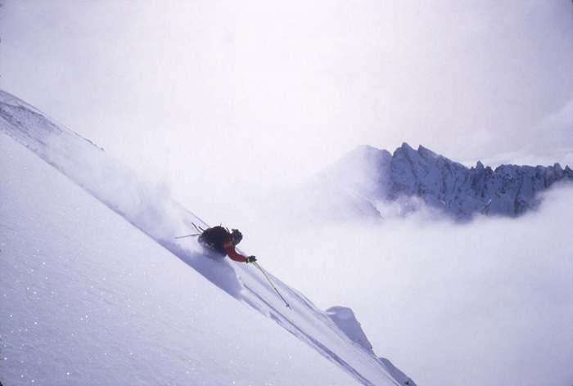
Reciprocal Teaching:
“Is the ongoing dialogue between teacher and student in which both take turns assuming the role of leading and following for the purpose of’:
Examining multiple experiences
Making sense of what is going on
Exercise ‘differential diagnostics’
Generate dialogue from which to move to action
Learning ‘Forecasting & Predicting’ - open-skill MUST!
Reveal invisible factors
Increase the sense of ‘Ownership = ‘Active Learning’ – Learning Addiction
Allow for learning to take place that cannot be taught
- Annemarie Sullivan Palincsar

Slide 24

Managing Energy
Energy Management
Definition:
The extent to which a person or team mobilizes
its emotional, cognitive and behavioral potential
to pursue a goal.
Hi- Positive Energy =
4 to 6 X Results

Slide 25
High Performance Team Characteristics
SOURCE: Losada & Heaphy, 2003
Team Performance
High Medium Low
Positive / Critical Ratio 5.6 : 1 1.8 : 1 .36 : 1
Ask / Tell 1.1 : 1 .67 : 1 .05 : 1
Others/Me Ratio .94 : 1 .62 : 1 .03 : 1
(internal / external focus)
Connectivity Average 32 22 18
(mutual influence, assistance, support)

Slide 26
Factoid
When resolving a challenge, the brain releases a rush of neurotransmitters like adrenaline, dopamine – creating a ‘learning addiction’.
Instructor’s challenge: Determine when to teach by
  ‘giving instructions’
  ‘guided discovery’
  ‘free to experiment’
When instruction predominantly relies upon ‘do as I do’, teaching gets in the way of creating a ‘learning addiction’ and prevents ‘active learning’.
Source: QEEG - Quantitative Cognitive Science.

Slide 27
Flow
Mihaly Czikszentmihalyi
PANIC ZONE
FLOW calm, focused, productive tension , energized “CAN DO”
Low Challenge High
DRONE ZONE
Low SKILLS High

Slide 28
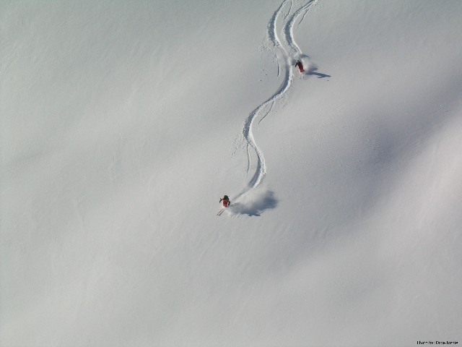
11 paradoxical messages I want you to remember……..
Research on learning- and performance management suggest:
Technique gets in the way of experiential learning
Not all sports are the same: Any Riding is an ‘Open Skill’ sport
Replace Technique with ‘Play and Experimentation’
Learning trumps Knowing
Instructors are Designers of learning/performing/social environments
Replace ED/EC with ‘Best Self’ teaching
‘Active Learning’ is best prompted by ‘Task-Community-Support’
Group lessons trump single person lessons in value and impact
The ‘Heliotropic Effect’ – What is your emotional wake?
Manage your and other’s Energy
Move from MA to SA

Slide 29
A Profession in Transition!
You are the most influential people in the industry.
Help keep our profession relevant by moving it into the new millennium?
Happy Holidays!
Horst Abraham
ha81657@gmail.com

