Slide 1
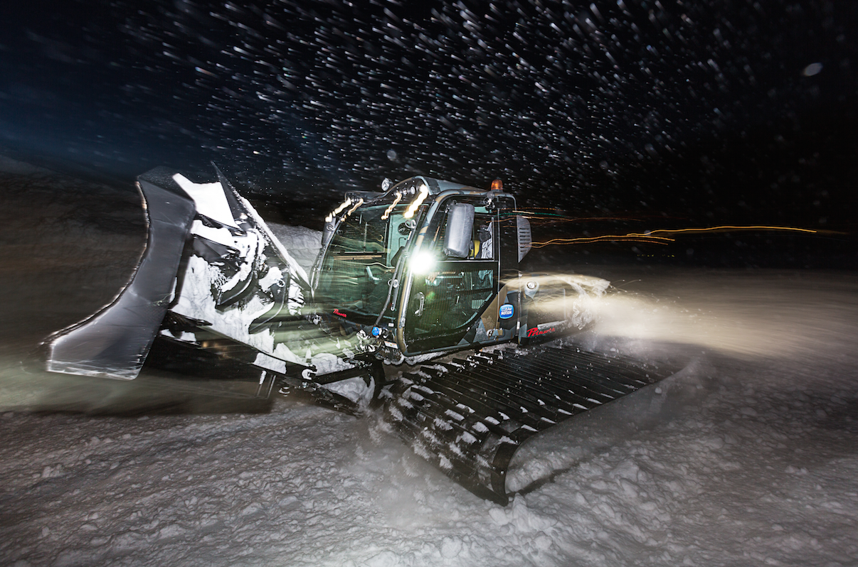
PARK METRICS & DATA

Slide 2

AGENDA
Terrain Park Data & Metrics
Progression Park Example
Notes:
Data and how it can be used tactically, influence resort owners and operators and thus support Terrain Park Managers
An example resort out West and how data was used to refine their product, enhance the guest experience, compete in the region, regain market share and do so with the same amount of resources
Going create a fictitious resort example with audience participation for some data discovery

Slide 3
BENEFITS OF METRICS & DATA
Analytical Understanding of Terrain Parks
Improved insights allowing for enhanced planning, benchmarking and evaluating
The ability to make educated and informed decisions, resulting in park program improvements
Answer questions that aren’t immediately obvious
Allow for on-going comparisons

Slide 4
BENEFITS OF TERRAIN PARK METRICS
Unify direction and understanding: Management, Department & Staff
Increased park usage and guest satisfaction
Employee retention and decreased burnout
Delivery of a premium product every day
Increased efficiencies
Industry right-sizing of features and effort focus

Slide 5
PROGRAM DETAILS – SIZING
SPT Park Metrics General Sizing Classification*
 | Snow Features | Jib Features
Size Designation | Deck Length Range | Feature Length Range | Other Factors
START Parks (Teaching) | X < 5' | X < 5' | • < 6" off ground
 |  |  | • No kinks
 |  |  | • Ride On
Small | 5' < X > 20' | 5' < X > 15' | • < 1.5' off ground
 |  |  | • No kinks
 |  |  | • Ride On
Medium | 20' < X > 40' | 15' < X > 25' | • < 3' off ground
 |  |  | • Up to one kink
Large** | 40' < X | 25' < X | • > 1 kink
* Size designations contained within the SPT Park Metrics Sizing Classification worksheet are APPROXIMATE and intended only to be used for creating Measuring Guidelines for data capture purposes. It is also recognized that individual resorts may work outside the established classifications, due to local considerations.
** Please note any snow features that have a deck length range larger than 60'
Notes:
Might not be how you look at the parks but how average users look at things

Slide 6
SPT RESORT RECOMMENDATIONS
SPT Defines a resort’s Terrain Park “Product Mix” as the features that go into the terrain park. A product mix consists of:
Total Number of Terrain Park Features
Type of Terrain Park Features: Jumps, Rollers, Berms, Jibs, Boxes, Pipes, & Hips
Sizing of Features: Extra Small, Small, Medium, & Large
Below is an example of a potential sizing product mix for a resort.
**This is just an example
Notes:
SPT assisted by using data to convince management to shift their feature percentage and as well collected data at a competitive resort in the region to compare
SPT partner was higher in large aspirational features, more so then competitive or partner resort thought
By shifting sizing and feature mix we delivered actual results, increase product level, increased park usage, increase all around park experience and kept labor the same
As well we increased job satisfaction, employee retention and pass sales
The TPM thus had a more popular park, more efficient use of resources allowing him to do more, in fact actually increased the number of features and parks. Increased seasons pass sales/resort profit which was measurable. Populartiy of park grew and so did its resources and sponsorship opportunities.

Slide 7
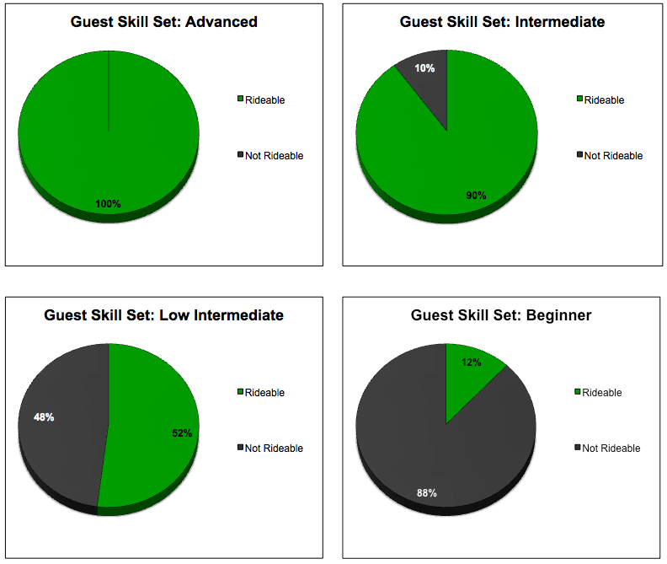
SPT RESORT RECOMMENDATIONS
The following is an example of how the previous page terrain park product mix affects the terrain provided for your consumers. Advanced riders can use anything from XS to large features, yet beginners can only use beginner terrain, affecting the number of rideable features for this given group of guests.
Notes:
SPT assisted by using data to convince management to shift their feature percentage and as well collected data at a competitive resort in the region to compare
SPT partner was higher in large aspirational features, more so then competitive or partner resort thought
By shifting sizing and feature mix we delivered actual results, increase product level, increased park usage, increase all around park experience and kept labor the same
As well we increased job satisfaction, employee retention and pass sales
The TPM thus had a more popular park, more efficient use of resources allowing him to do more, in fact actually increased the number of features and parks. Increased seasons pass sales/resort profit which was measurable. Populartiy of park grew and so did its resources and sponsorship opportunities.

Slide 8
Glossary of Terms
The NSAA (National Ski Area Association) Glossary of Terms is supplied to help define the components of a jump and create consistency throughout the industry.
**Note: This is a condensed/reduced version

Slide 9
Glossary of Terms (Reduced)
APPROACH
Approach – The downhill sloping surface loading into the approach transition.
Approach Transition – The curved part of the jump connecting the approach to the takeoff transition.
Zero – The point at which the approach meets the takeoff – should be equivalent to zero
TAKEOFF
Takeoff Transition – The part of the takeoff whose surface begins at the horizontal and ends at the takeoff angle.
Lip – The terminus (last edge) of the takeoff surface.
Back of the Takeoff – The surface connecting the end of the top of the takeoff to the start of the deck of the jump (or landing region if there is no deck).

Slide 10
Glossary of Terms (Reduced)
DECK
Deck – The surface between the back of the takeoff and the start of the landing plane (including the knuckle).
Fly-By (Bypass) Lane – The surface on either or both sides of the takeoff which joins the approach transition to the deck.
Knuckle – The surface transition between the deck and the landing region.
LANDING
Landing Plane – The surface between the knuckle and the run-out.
Landing Transition/Toe – The transition between the landing region and the run-out.
Run-Out – The surface immediately following the end of the landing transition, returning the user to the parent slope.
Parent Slope – the sliding surface within the terrain park upon which the feature is placed or constructed. The surface shape generally changes with position on the slope.

Slide 11
Progression Park Example
The following examples show what a progression park could look like at your resort.

Slide 12
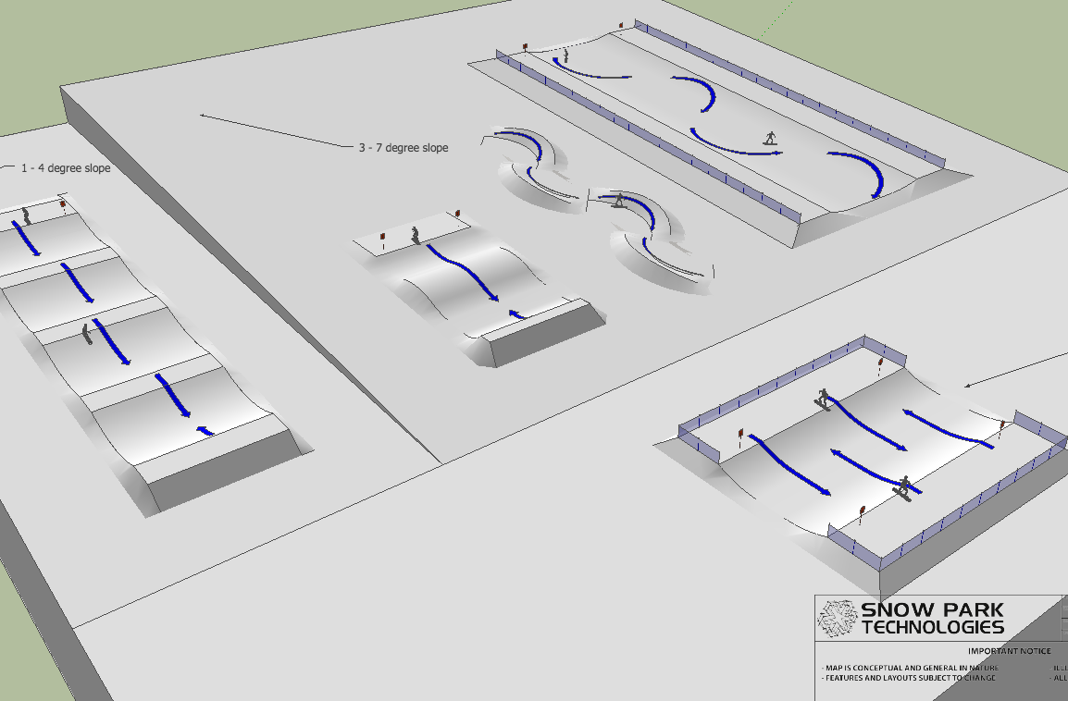
Progression Park Example

Slide 13
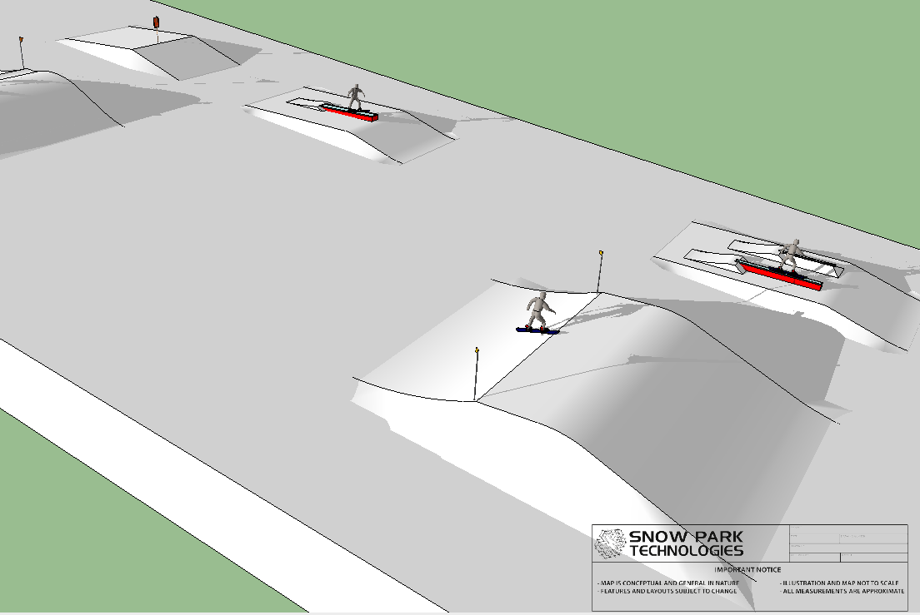
Progression Park Example

Slide 14
Thank You
Josh Chauvet
Director of Marketing, SPT Parks
E. josh@snowparktech.com
P. (949) 338-3816
Mike Bettera
Director of Operations, SPT Parks
E. mike@snowparktech.com
P. (530) 448-0591

