Slide 2
Open/Closed Skills
Objectives:
Develop a shared understanding of the distinction between the two types of skills.
Identify ‘open skill’- appropriate teaching methods.
Identify the ‘open skill’ instructor competencies.

Slide 3
Skill Distinction
Open Motor Skills
Unstable environment
Many and changing variables (internal – external)
Start -, mid- and end points of skill execution are to a great extent externally dictated
Repeated decision making required
Timing, duration and intensity of skill execution is externally (people, environment) dictated.
Feedback from task, environment, perception.
Closed Motor Skills
Stationary environment
No or very limited variables (internal – external)
Performer dictates timing and extent
Typically done in solo performance
Easier to learn
Feedback is task specific

Slide 4
The Skill Spectrum
Closed Open
Mixed
Teachable Learnable
*Self paced * Externally paced
*Massed practice * Distributed practice
*Drill – Fixed skill * Experimentation
Tennis - Diving - Skiing – Boarding - Basket Ball – Golf – Other?

Slide 5
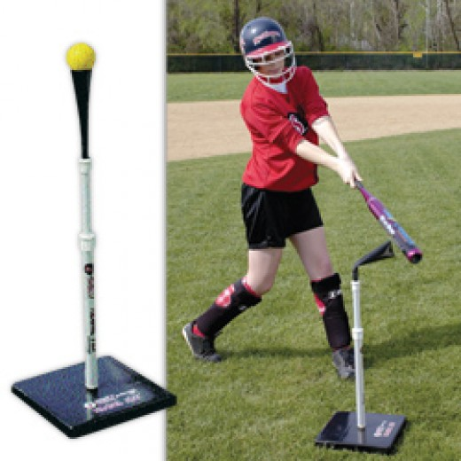

Slide 6
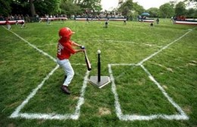

Slide 7
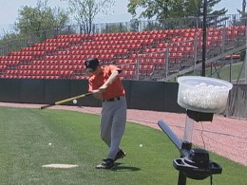

Slide 8
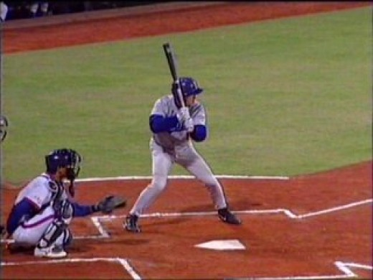

Slide 9
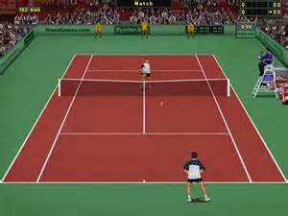

Slide 10
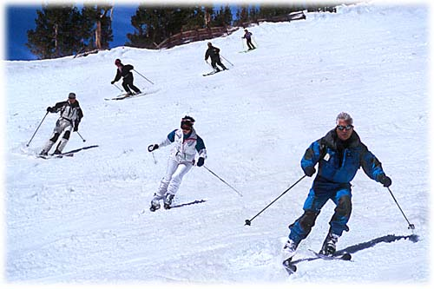
Case Study
Examine the skier in the foreground:
What is your assessment?
What is your development focus?
What actions do you propose?
To what end?

Slide 11
Open Skill Methodologies
____________________________________________________________________________________________________________________________________________________________________________________ ______________________________________________________________________________________________________________________________________________________________________________________________________________________________________________________________________________

Slide 12
Open Skill Competencies
____________________________________________________________________________________________________________________________________________________________________________________________________________________________________________________________________________________________________________________________________________________________________________________________________________________________________

Slide 13
The Magic of Questions
Past____________________________________________________________________________________________________________________________________________________________________________
Present_________________________________________________________________________________________________________________________________________________________________________
Future______________________________________________________________________________________________________________________________

Slide 14
From…… | To……
Technique & Instructor Focus | Learner & Experience Focus
Tell | Questions
Strive to be Understood | Strive to understand
Task skills | Learning and Interpersonal Skills
Disciplined conformance | Play and experimentation
Judgment | Empathy – Humility - Encouragement
Extrinsic Feedback | Intrinsic Feedback
Extrinsic motivation | Intrinsic motivation
Knowledge | Curiosity
Command & Control | Autonomy& Self Discovery
Instructor driven process | Collaborative process
Technical Language | VAKE + Sensory Language
Managing Time | Managing Energy
Deficit Gap | Possibility Gap

Slide 15
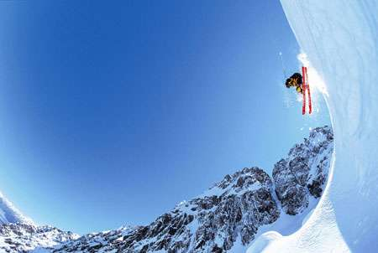
People Generally Remember….. 10% of what they READ 20% of what they HEAR 30% of what they SEE 50% of what they SEE and HEAR 70% of what they SAY or WRITE 90% of what they DO!

Slide 16
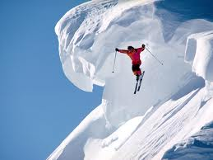
Parker Palmer
“Technique is used until the
real teacher shows up”.

Slide 17
KNAPP, B. (1967) Skill in Sport: The Atrainment of Proficiency. Routledge & Kegan Paul
GALLIGAN, F. et al. (2000)Acquiring Skill In: GALLIGAN, F. et al., Advanced PE for Edexcel. 1st ed. Bath: Bath Press, p. 102-108
DAVIS, B. et al. (2000) The Nature and classification of skill. In: DAVIS, B. et al. Physical Education and the study of sport. 4th ed. Spain: Harcourt Publishers, p. 284-285

